Slide 1

BY
KIDDEE LAB

Slide 2


Slide 3
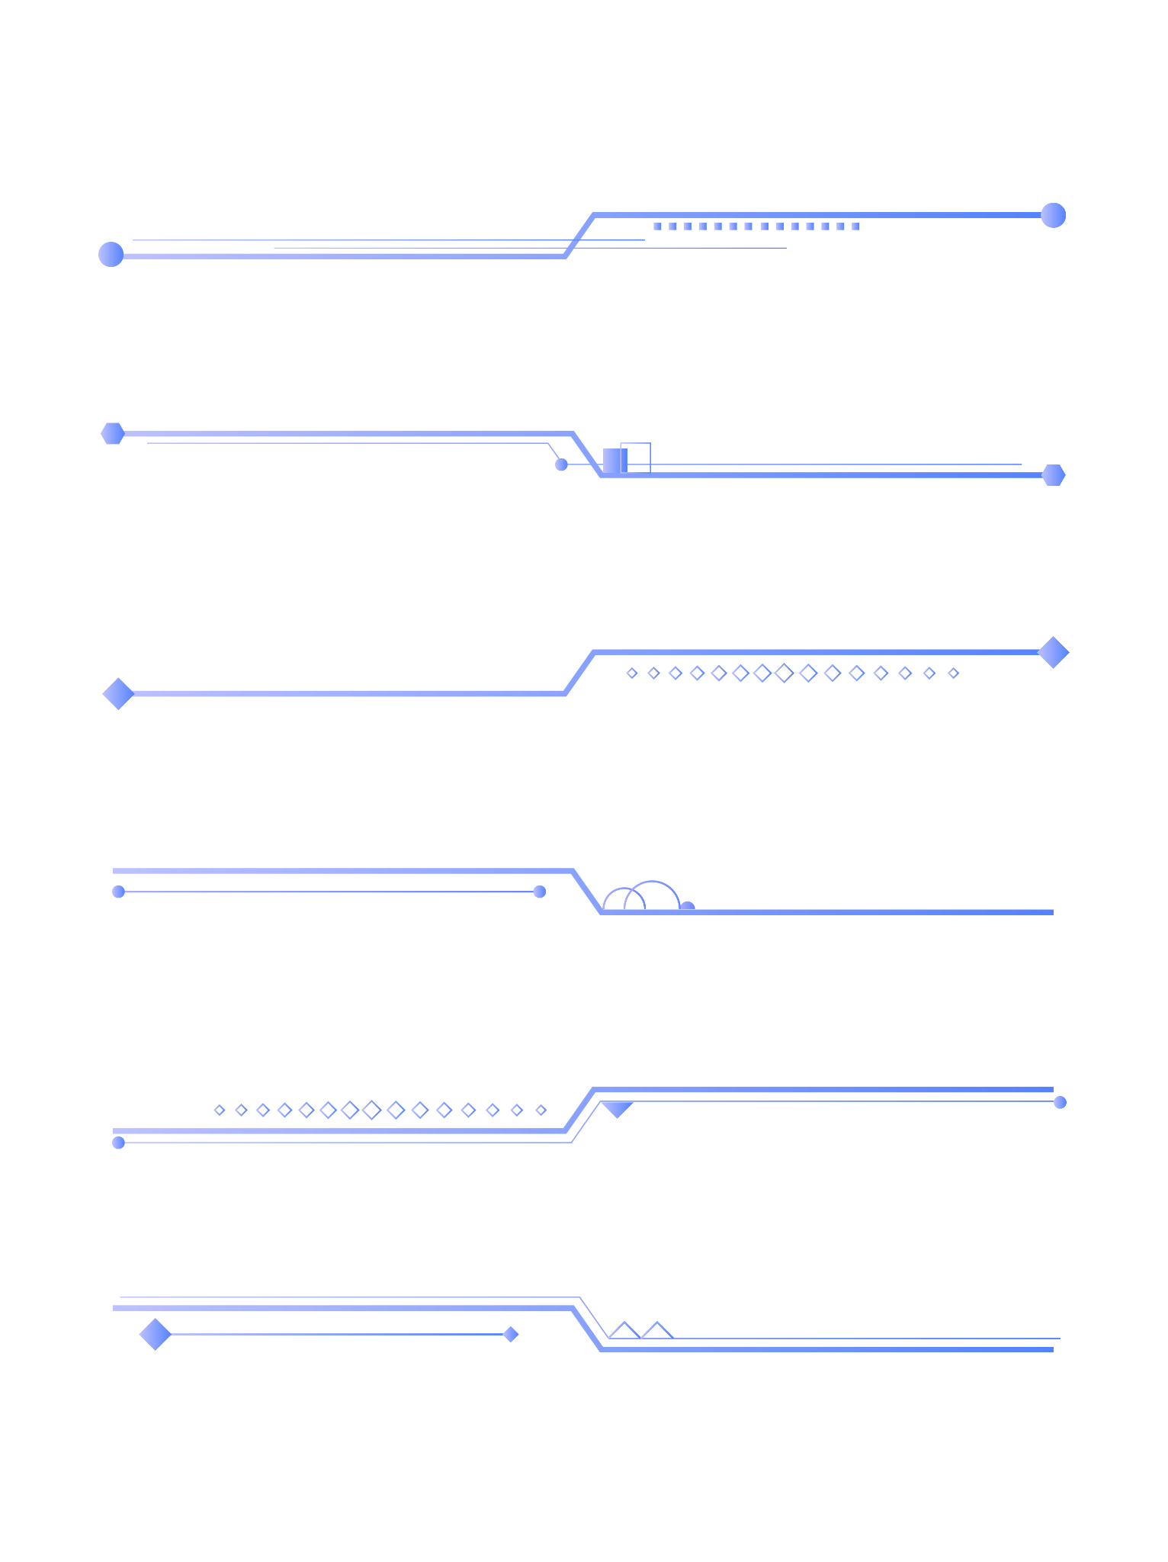
Before we start
Install Python 3.8.10
Install Pygame
1
2
CT-PyGame KIDDEE LAB

Slide 4
Before we start
Install Python 3.8.10
Install Pygame
1
2

Slide 5
Install Python 3.8.10
Download Python 3.8.10

Slide 6
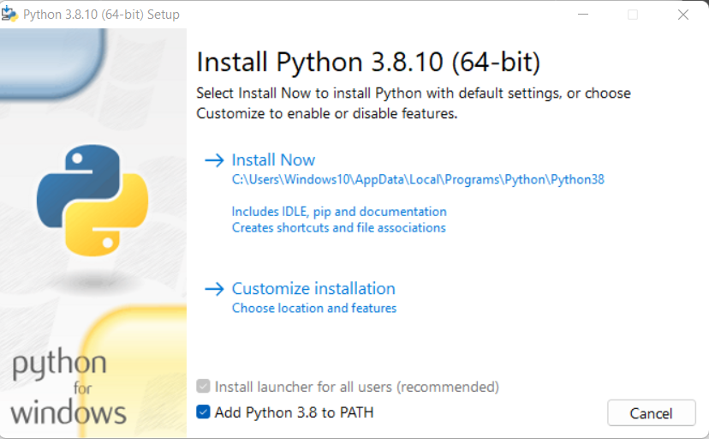
Install Python 3.8.10
Install
Don’t forget to check this box!

Slide 7
Before we start
Install Python 3.8.10
Install Pygame
1
2

Slide 8
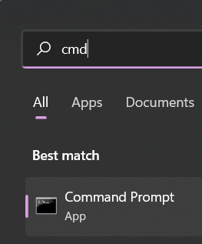
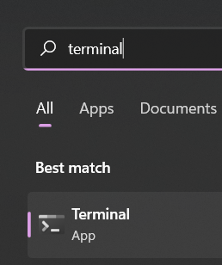
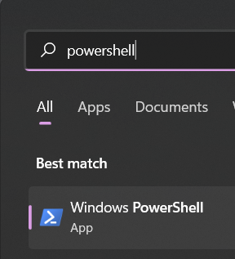
Install Pygame
Open CMD or Terminal or Powershell

Slide 9
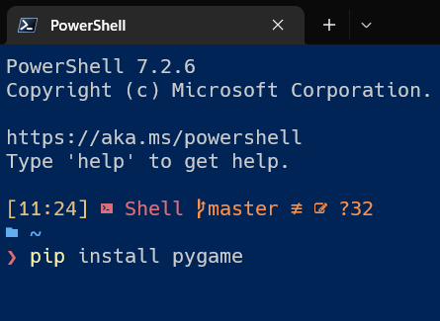
Install Pygame
Type ‘pip install pygame’

Slide 10
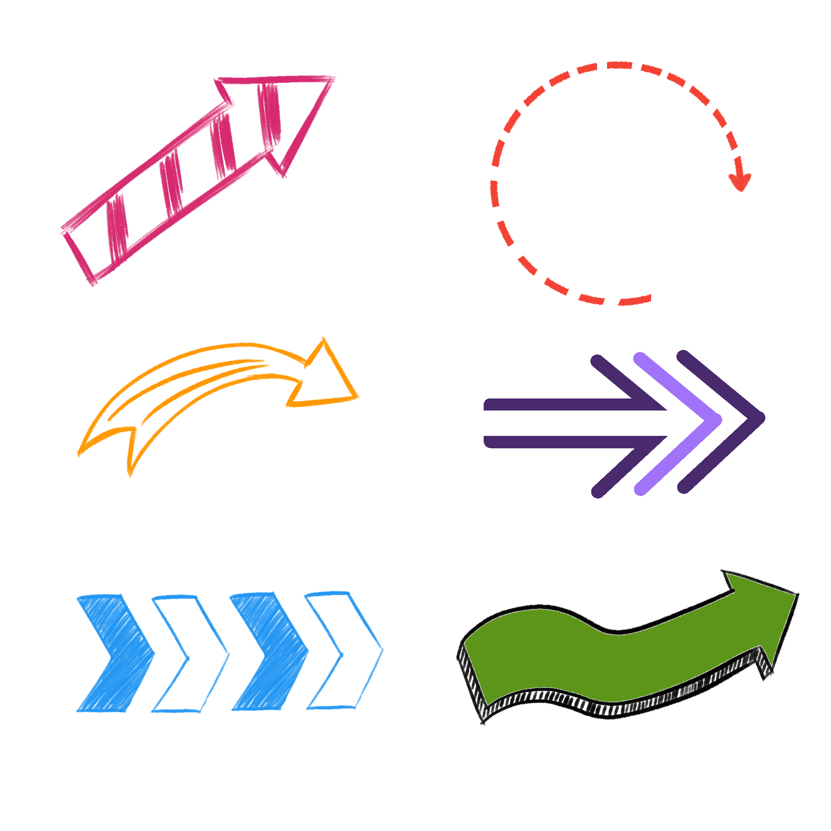
Overview
What is pygame?
What is game engine?
Reasons why you should learn pygame

Slide 11
What is pygame?
Pygame helps you draw images
Check for player input
Have gamedev tools (collision,timer,etc.)

Slide 12
What is game engine?
Programmes that help making games by giving tools such as level editor, physics engine and much more
Example: Unreal, Unity, Godot

Slide 13
Reasons why you should learn pygame
You learn to solve the problems by yourself and become a good programmer in general
You can learn a new game engine very quickly

Slide 14
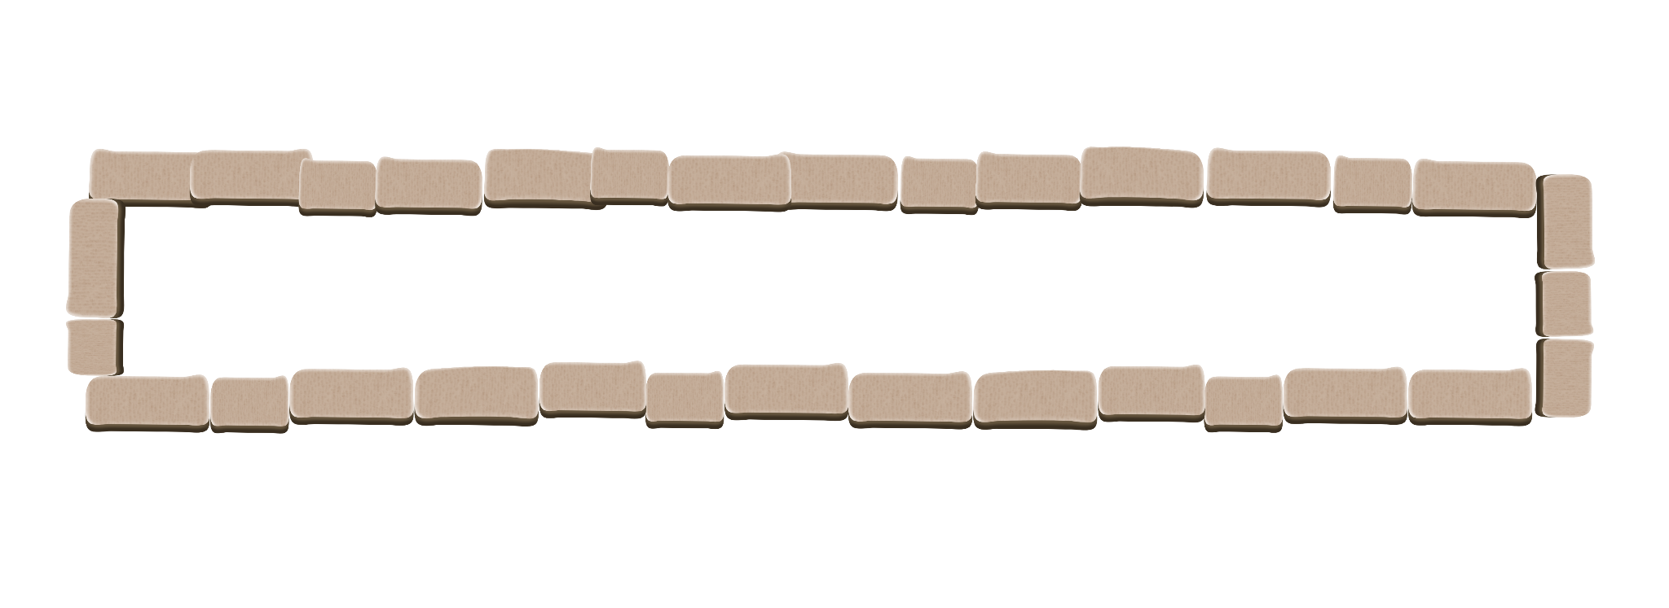
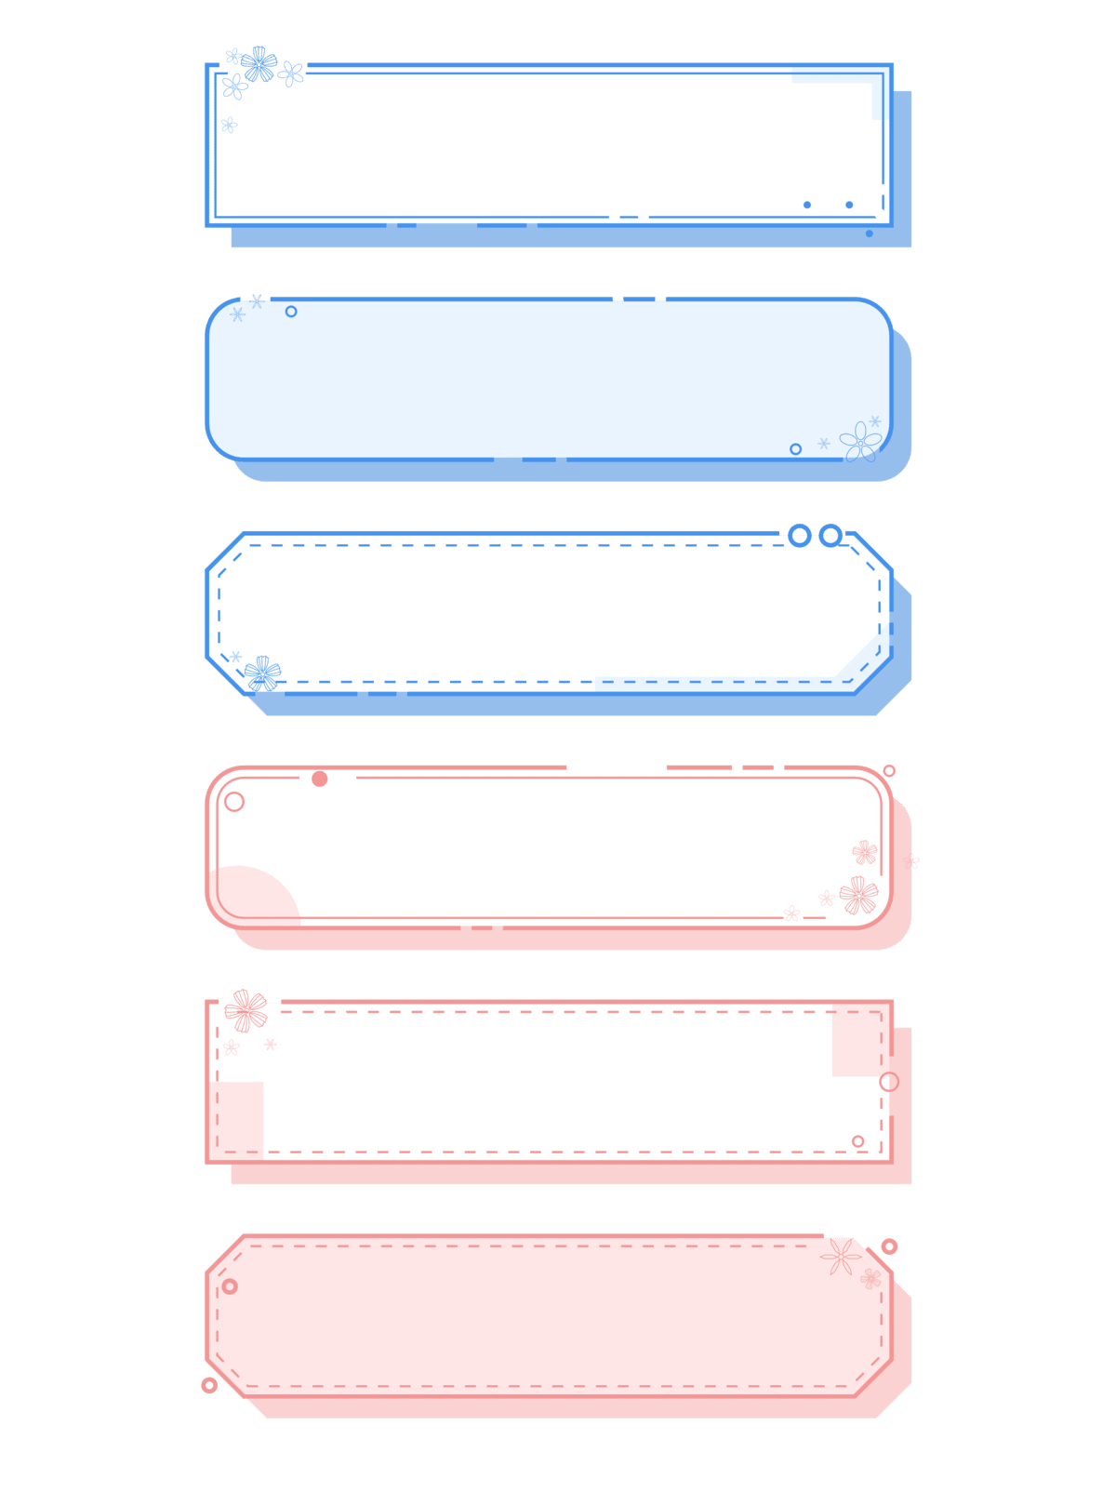
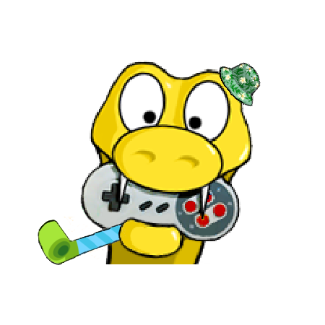
Chapter 1
Displaying Image

Slide 15
Syntax: Display
pygame.display.set_mode((w,h)) w, h = width, height | Initialize a window for display
pygame.display.update() | Update portions of the screen
pygame.display.flip() | Update the full display Surface to the screen
pygame.display.set_caption() | Set window caption
pygame.display.set_icon() | Set window icon

Slide 16
Syntax: Display
Example
screen = pygame.display.set_mode((800,400))
pygame.display.set_caption(‘Astro Jumper’)

Slide 17
Syntax: Event
pygame.event.get() | Get events from the list below: Quit USEREVENT KEYDOWN KEYUP MOUSEBUTTONDOWN MOUSEBUTTONUP USEREVENT
pygame.event.EventType.type() | Get access to events from the list

Slide 18
Syntax: Event
Example
for event in pygame.event.get():
if event.type == pygame.QUIT:
pygame.quit()
exit()
# Instead of using pygame.event.EventType.type(),
# we use “for loops” for checking event

Slide 19
Pygame window general setup
import pygame
from sys import exit
pygame.init()
screen = pygame.display.set_mode((800,400))
pygame.display.set_caption(‘Astro Jumper’)
while True:
for event in pygame.event.get():
if event.type == pygame.QUIT:
pygame.quit()
exit()
pygame.display.update()

Slide 20
Syntax: Time
pygame.time.get_ticks() | Get time in milliseconds
pygame.time.set_timer() | Create an event on the event queue (In a nutshell: create timer)
pygame.time.Clock() | Crate an object to help track of time

Slide 21
Syntax: pygame.time.Clock()
pygame.time.Clock.tick() | Get time in milliseconds
pygame.time.Clock.get_time() | Create an event on the event queue (In a nutshell: create timer)

Slide 22
Set frame rate
import pygame
from sys import exit
pygame.init()
screen = pygame.display.set_mode((800,400))
pygame.display.set_caption(‘Astro Jumper’)
clock = pygame.time.Clock()

Slide 23
while True:
for event in pygame.event.get():
if event.type == pygame.QUIT:
pygame.quit()
exit()
pygame.display.update()
clock.tick(60)

Slide 24
Syntax: Surface
pygame.Surface((w,h)) w, h = width, height | Pygame object represent images
pygame.Surface.blit() | Draw one image onto another
pygame.Surface.blits() | Draw many images onto another
pygame.Surface.fill() | Fill Surface with a solid color

Slide 25
Setup Surface
import pygame
from sys import exit
pygame.init()
screen = pygame.display.set_mode((800,400))
pygame.display.set_caption(‘Astro Jumper’)
clock = pygame.time.Clock()
test_surface = pygame.Surface((100,200))
test_surface.fill(‘Red’)

Slide 26
while True:
for event in pygame.event.get():
if event.type == pygame.QUIT:
pygame.quit()
exit()
screen.blit(test_surface,(0,0))
pygame.display.update()
clock.tick(60)

Slide 27
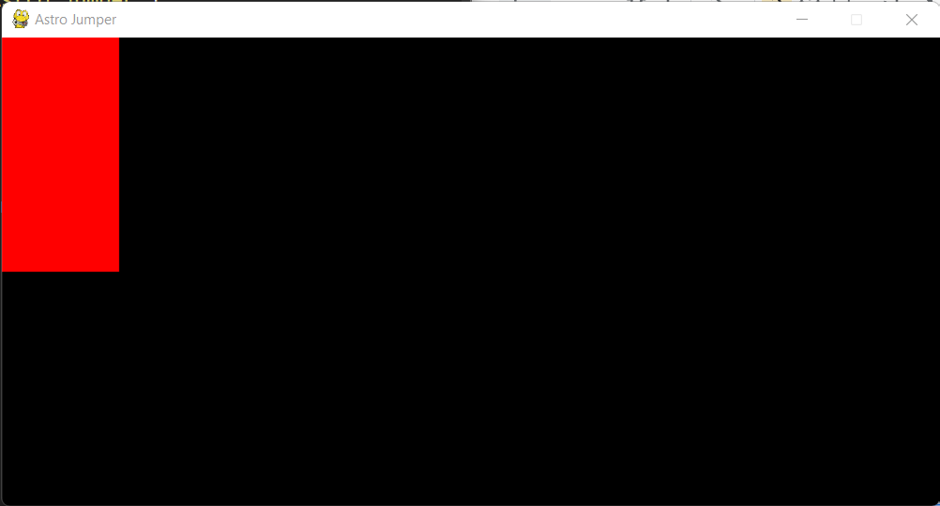

Slide 28
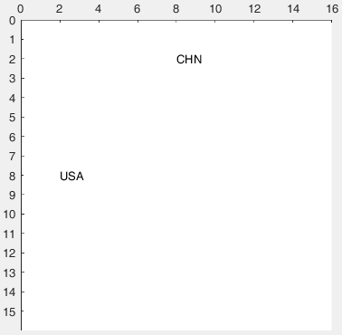
As we can see Pygame will recognize the coordinate as the top left corner of our image since we place the Surface at (0,0)
Not to scale

Slide 29
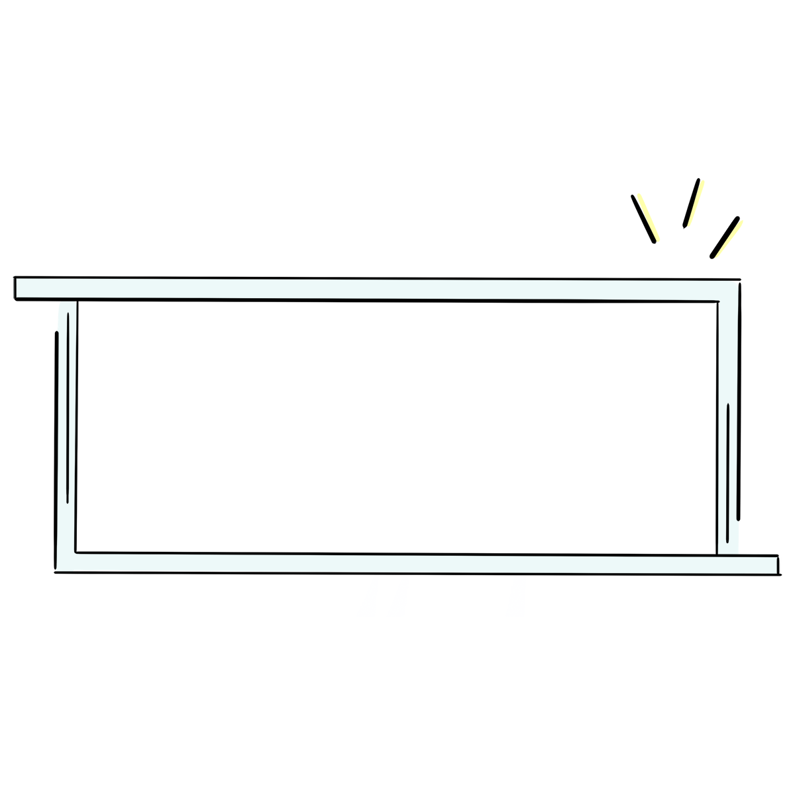
Exercise 1
Place the red rectangle 100 unit from the left and 50 unit from the top

Slide 30
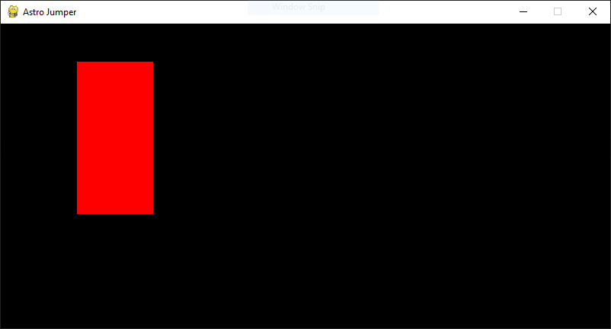

Slide 31
Exercise 1: Answer
import pygame
from sys import exit
pygame.init()
screen = pygame.display.set_mode((800,400))
pygame.display.set_caption(‘Astro Jumper’)
clock = pygame.time.Clock()
test_surface = pygame.Surface((100,200))
test_surface.fill(‘Red’)

Slide 32
while True:
for event in pygame.event.get():
if event.type == pygame.QUIT:
pygame.quit()
exit()
screen.blit(test_surface,(100,50))
pygame.display.update()
clock.tick(60)

Slide 33
Syntax: Image
pygame.image.load() | Load new image from a file
Image is one kind of the Surface

Slide 34
Syntax: Image
Example
example_surf = pygame.image.load(‘graphics/ground.png’).convert_alpha()

Slide 35
Exercise 2
Instead of red rectangle, use the ‘sky.png’ in the ‘graphics’ folder and place it at the top left corner
After that place the ‘ground.png’ below the sky

Slide 36
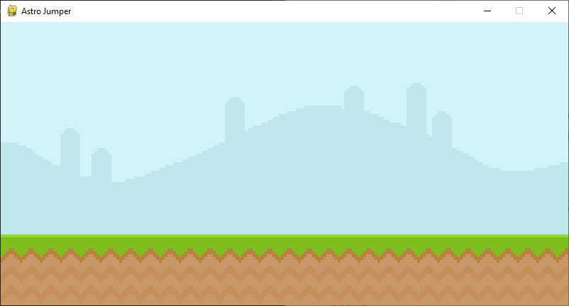

Slide 37
Exercise 2: Answer
import pygame
from sys import exit
pygame.init()
screen = pygame.display.set_mode((800,400))
pygame.display.set_caption(‘Astro Jumper’)
clock = pygame.time.Clock()
sky_surf = pygame.image.load(‘graphics/sky.png’).convert_alpha()
ground_surf = pygame.image.load(‘graphics/ground.png’).convert_alpha()

Slide 38
while True:
for event in pygame.event.get():
if event.type == pygame.QUIT:
pygame.quit()
exit()
screen.blit(sky_surf,(0,0))
screen.blit(ground_surf,(0,300))
pygame.display.update()
clock.tick(60)

Slide 39
Syntax: Font
pygame.font.Font(f,s) f, s = filename, size | Create a new Font object from a file

Slide 40
Syntax: pygame.font.Font()
pygame.font.Font.render(t,a,c) t = ‘text’ a = antialias (True, False) c = ‘color’ or (r,g,b) | Draw a text on a new surface
pygame.font.Font.bold() | Gets or sets whether the font should be rendered in (faked) bold
pygame.font.Font.italic() | Gets or sets whether the font should be rendered in (faked) italic

Slide 41
Syntax: Font
Example
example_font = pygame.font.Font(‘font/Arial.ttf’,50)
example_text_surface = example_font.render(‘example’, False, ‘Blue’)

Slide 42
Exercise 3
Use font name ‘Pixeltype.ttf’, color is Black and place the text label ‘MY GAME’ at the top center of the screen

Slide 43
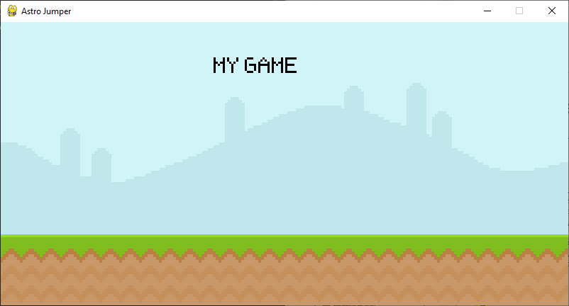

Slide 44
Exercise 3: Answer
import pygame
from sys import exit
pygame.init()
screen = pygame.display.set_mode((800,400))
pygame.display.set_caption(‘Astro Jumper’)
clock = pygame.time.Clock()
loaded_font = pygame.font.Font(‘font/Pixeltype.ttf’,50)
sky_surf = pygame.image.load(‘graphics/sky.png’).convert_alpha()
ground_surf = pygame.image.load(‘graphics/ground.png’).convert_alpha()
text_surf = loaded_font.render(‘MY GAME’, False, ‘Black’)

Slide 45
while True:
for event in pygame.event.get():
if event.type == pygame.QUIT:
pygame.quit()
exit()
screen.blit(sky_surf,(0,0))
screen.blit(ground_surf,(0,300))
screen.blit(text_surf,(300,50))
pygame.display.update()
clock.tick(60)

Slide 46
Chapter 2
Basic animation

Slide 47
Exercise 4
Place the ‘snail1.png’ in the ‘graphics’ folder on the right most at the ground

Slide 48
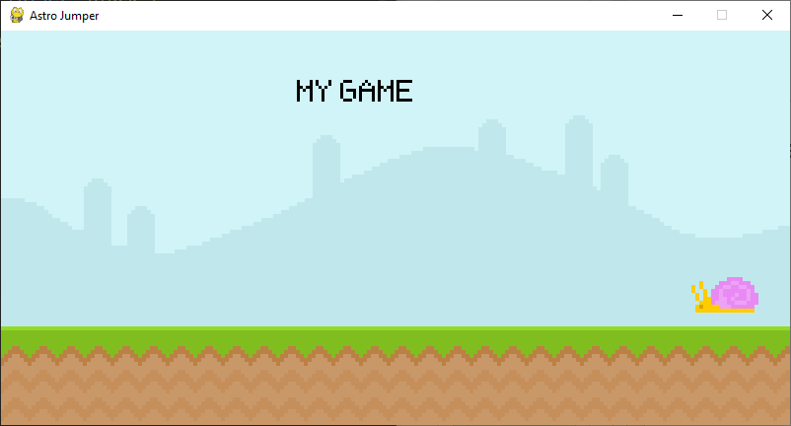

Slide 49
Exercise 4: Answer
import pygame
from sys import exit
pygame.init()
screen = pygame.display.set_mode((800,400))
pygame.display.set_caption(‘Astro Jumper’)
clock = pygame.time.Clock()
loaded_font = pygame.font.Font(‘font/Pixeltype.ttf’,50)
sky_surf = pygame.image.load(‘graphics/sky.png’).convert_alpha()
ground_surf = pygame.image.load(‘graphics/ground.png’).convert_alpha()
text_surf = loaded_font.render(‘MY GAME’, False, ‘Black’)
snail_surf = pygame.image.load('graphics/snail/snail1.png').convert_alpha()

Slide 50
while True:
for event in pygame.event.get():
if event.type == pygame.QUIT:
pygame.quit()
exit()
screen.blit(sky_surf,(0,0))
screen.blit(ground_surf,(0,300))
screen.blit(text_surf,(300,50))
screen.blit(snail_surf,(700,250))
pygame.display.update()
clock.tick(60)

Slide 51
Exercise 5
Since we know that the top left is (0,0)
Create a new variable to be x position of the snail and make the snail moves to the left
Hint: use += or -=
If the snail is going out of the screen make it response at the start position

Slide 52
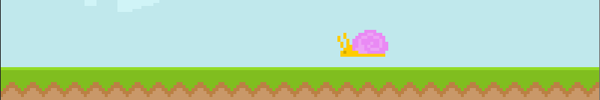
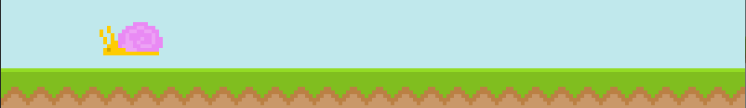

Slide 53
Exercise 5: Answer
import pygame
from sys import exit
pygame.init()
screen = pygame.display.set_mode((800,400))
pygame.display.set_caption(‘Astro Jumper’)
clock = pygame.time.Clock()
loaded_font = pygame.font.Font(‘font/Pixeltype.ttf’,50)
sky_surf = pygame.image.load(‘graphics/sky.png’).convert_alpha()
ground_surf = pygame.image.load(‘graphics/ground.png’).convert_alpha()
text_surf = loaded_font.render(‘MY GAME’, False, ‘Black’)
snail_surf = pygame.image.load('graphics/snail/snail1.png').convert_alpha()
snail_x = 700

Slide 54
while True:
for event in pygame.event.get():
if event.type == pygame.QUIT:
pygame.quit()
exit()
screen.blit(sky_surf,(0,0))
screen.blit(ground_surf,(0,300))
screen.blit(text_surf,(300,50))
snail_x -= 2
if snail_x < -100: snail_x = 700
screen.blit(snail_surf,(snail_x,250))
pygame.display.update()
clock.tick(60)

Slide 55
Chapter 3
Rectangle

Slide 56
What will a Rectangle help us?
Precise position of surfaces
Basic collision

Slide 57
What will a Rectangle help us?
Precise position of surfaces
Basic collision

Slide 58
Rectangle object: tuple (x,y) values
midtop
topleft
topright
center
midleft
midright
bottomleft
bottomright
midbottom

Slide 59
Rectangle object: individual values
top
x,y
centerx, centery
left
right
bottom

Slide 60
Syntax: Rectangle
pygame.Rect(L,T,W,H) L, T, W, H = Left, Top, Width, Height | Create a rectangle
We don’t use this one here

Slide 61
Syntax: Surface
pygame.Surface.get_rect() | Get the rectangular area of the Surface

Slide 62
Syntax: Surface
Example
example_surf = pygame.image.load(‘graphics/player/
player_walk_1.png’).convert_alpha()
example_rect = example_surf.get_rect(topleft = (80,200))
while True:
.
.
.
screen.blit(example_surf, example_rect)

Slide 63
Exercise 6
Create a player surface from image name ‘Walking1.png’ in folder ‘graphics/Player’
Place the player on the left side of the screen, at same level of the snail by using Rectangle method

Slide 64
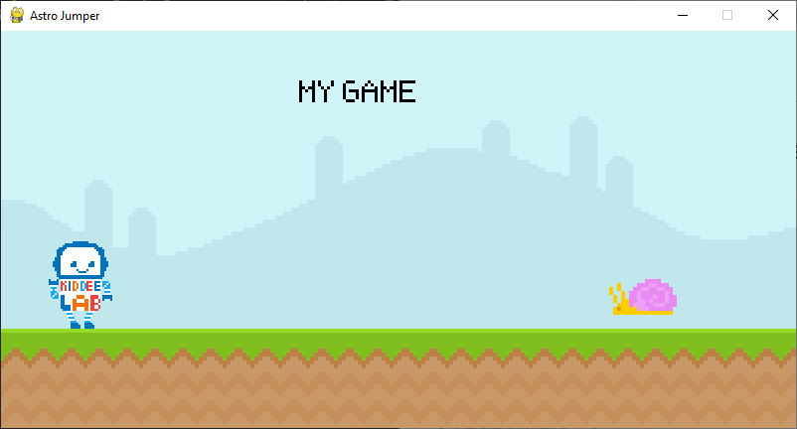

Slide 65
Exercise 6: Answer
import pygame
from sys import exit
pygame.init()
screen = pygame.display.set_mode((800,400))
pygame.display.set_caption(‘Astro Jumper’)
clock = pygame.time.Clock()
loaded_font = pygame.font.Font(‘font/Pixeltype.ttf’,50)
sky_surf = pygame.image.load(‘graphics/sky.png’).convert_alpha()
ground_surf = pygame.image.load(‘graphics/ground.png’).convert_alpha()
text_surf = loaded_font.render(‘MY GAME’, False, ‘Black’)

Slide 66
Exercise 6: Answer
snail_surf = pygame.image.load('graphics/snail/snail1.png').convert_alpha()
snail_x = 700
player_surf = pygame.image.load().convert_alpha()
player_rect = player_surf.get_rect(midbottom = (80,300))
while True:
for event in pygame.event.get():
if event.type == pygame.QUIT:
pygame.quit()
exit()

Slide 67
screen.blit(sky_surf,(0,0))
screen.blit(ground_surf,(0,300))
screen.blit(text_surf,(300,50))
snail_x -= 2
if snail_x < -100: snail_x = 700
screen.blit(snail_surf,(snail_x,250))
screen.blit(player_surf,player_rect)
pygame.display.update()
clock.tick(60)

Slide 68
Exercise 7
Do the same thing in the exercise 6 but now for the snail
Also make the snail start off screen, move it with the speed of -5 and reset the position by using Rectangle method
Hint: refer to Rectangle object values

Slide 69
Exercise 7: Answer
import pygame
from sys import exit
pygame.init()
screen = pygame.display.set_mode((800,400))
pygame.display.set_caption(‘Astro Jumper’)
clock = pygame.time.Clock()
loaded_font = pygame.font.Font(‘font/Pixeltype.ttf’,50)
sky_surf = pygame.image.load(‘graphics/sky.png’).convert_alpha()
ground_surf = pygame.image.load(‘graphics/ground.png’).convert_alpha()
text_surf = loaded_font.render(‘MY GAME’, False, ‘Black’)

Slide 70
snail_surf = pygame.image.load('graphics/snail/snail1.png').convert_alpha()
snail_rect = snail_surf.get_rect(midbottom = (80,300))
player_surf = pygame.image.load().convert_alpha()
player_rect = player_surf.get_rect(midbottom = (80,300))
while True:
for event in pygame.event.get():
if event.type == pygame.QUIT:
pygame.quit()
exit()

Slide 71
screen.blit(sky_surf,(0,0))
screen.blit(ground_surf,(0,300))
screen.blit(text_surf,(300,50))
snail_rect.x -= 5
if snail__rect.right < -5: snail_rect.left = 800
screen.blit(snail_surf,snail_rect)
screen.blit(player_surf,player_rect)
pygame.display.update()
clock.tick(60)

Slide 72
Chapter 4
Collision

Slide 73
Syntax: Rectangle
pygame.Rect.colliderect(r) r = another rectangle | Check if two rectangles overlap
pygame.Rect.collidepoint(x,y) x, y = coordinate | Check if a point inside the rectangle

Slide 74
Syntax: Rectangle (Collision)
Example
while True:
.
.
.
print(example1_rect.colliderect(example2_rect))

Slide 75
Exercise 8
Check if the snail hit the player or not by using colliderect method
If the do hit the player print out ‘Collide’

Slide 76
Exercise 8: Answer
import pygame
from sys import exit
pygame.init()
screen = pygame.display.set_mode((800,400))
pygame.display.set_caption(‘Astro Jumper’)
clock = pygame.time.Clock()
loaded_font = pygame.font.Font(‘font/Pixeltype.ttf’,50)
sky_surf = pygame.image.load(‘graphics/sky.png’).convert_alpha()
ground_surf = pygame.image.load(‘graphics/ground.png’).convert_alpha()
text_surf = loaded_font.render(‘MY GAME’, False, ‘Black’)

Slide 77
snail_surf = pygame.image.load('graphics/snail/snail1.png').convert_alpha()
snail_rect = snail_surf.get_rect(midbottom = (80,300))
player_surf = pygame.image.load().convert_alpha()
player_rect = player_surf.get_rect(midbottom = (80,300))
while True:
for event in pygame.event.get():
if event.type == pygame.QUIT:
pygame.quit()
exit()
screen.blit(sky_surf,(0,0))
screen.blit(ground_surf,(0,300))
screen.blit(text_surf,(300,50))

Slide 78
snail_rect.x -= 5
if snail__rect.right < -5: snail_rect.left = 800
screen.blit(snail_surf,snail_rect)
screen.blit(player_surf,player_rect)
if player_rect.colliderect(snail_rect):
print(‘collide’)
pygame.display.update()
clock.tick(60)

Slide 79
Chapter 5
Draw

Slide 80
Syntax: Draw
pygame.draw.rect(s,c,r,w,br) s,c,r,w,br = Surface, Color, Rectangle, Width, Border radius | Draw a rectangle
pygame.draw.line(s,c,sp,ep,w) sp,ep = Starting point, End point | Draw a line
pygame.draw.ellipse(s,c,r) | Draw a ellipse
pygame.draw.polygon(s,c,p) p = list of coordinate | Draw a polygon

Slide 81
Syntax: Draw
Example
screen = pygame.display.set_mode((800,400))
example_img = pygame.image.load(‘image.png’).convert_alpha()
example_rect = example_img.get_rect(center = (0,0))
while True:
.
.
.
pygame.draw.rect(screen, ‘Green’, example_rect,6,1)

Slide 82
Exercise 9
Change text ‘MY GAME’ to use rectangle method and place in the top middle of the screen
Using color (64,64,64) for text
Draw a rectangle to be a background
Using color #c0e8ec for BG

Slide 83
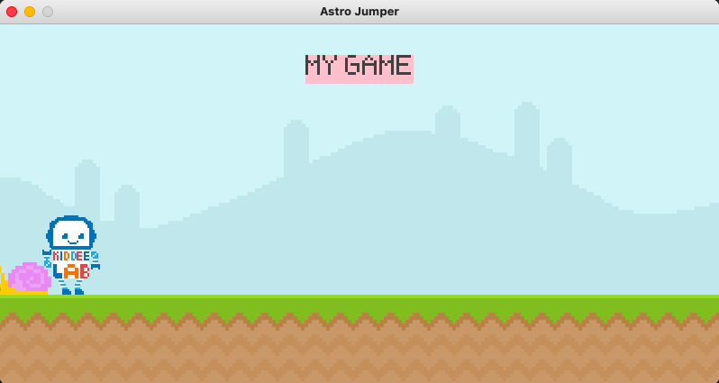

Slide 84
Exercise 9: Answer
import pygame
from sys import exit
pygame.init()
screen = pygame.display.set_mode((800,400))
pygame.display.set_caption(‘Astro Jumper’)
clock = pygame.time.Clock()
loaded_font = pygame.font.Font(‘font/Pixeltype.ttf’,50)

Slide 85
sky_surf = pygame.image.load(‘graphics/sky.png’).convert_alpha()
ground_surf = pygame.image.load(‘graphics/ground.png’).convert_alpha()
text_surf = loaded_font.render('MY GAME', False, (64,64,64))
text_rect = text_surf.get_rect(center = (400,50))
snail_surf = pygame.image.load('graphics/snail/snail1.png').convert_alpha()
snail_rect = snail_surf.get_rect(midbottom = (80,300))
player_surf = pygame.image.load().convert_alpha()
player_rect = player_surf.get_rect(midbottom = (80,300))

Slide 86
while True:
for event in pygame.event.get():
if event.type == pygame.QUIT:
pygame.quit()
exit()
screen.blit(sky_surf,(0,0))
screen.blit(ground_surf,(0,300))
pygame.draw.rect(screen,’Pink’,text_rect)
screen.blit(text_surf,(300,50))
snail_rect.x -= 5
if snail__rect.right < -5: snail_rect.left = 800
screen.blit(snail_surf,snail_rect)

Slide 87
screen.blit(player_surf,player_rect)
if player_rect.colliderect(snail_rect):
print(‘collide’)
pygame.display.update()
clock.tick(60)

Slide 88
Exercise 9: Extra
Create a rectangle to be a background of the text and place it properly

Slide 89
Chapter 6
Player

Slide 90
Player properties
Player can jump
When Player jump, Player must goes down due to gravity
When Player come down, Player must be on the floor

Slide 91
Player properties
Player can jump
When Player jump, Player must goes down due to gravity
When Player come down, Player must be on the floor

Slide 92
How can we detect user input?
Input is detected in Event loop
Input is detected in it own class (which will be used later on)

Slide 93
How can we detect user input?
Input is detected in Event loop
Input is detected in it own class (which will be used later on)

Slide 94
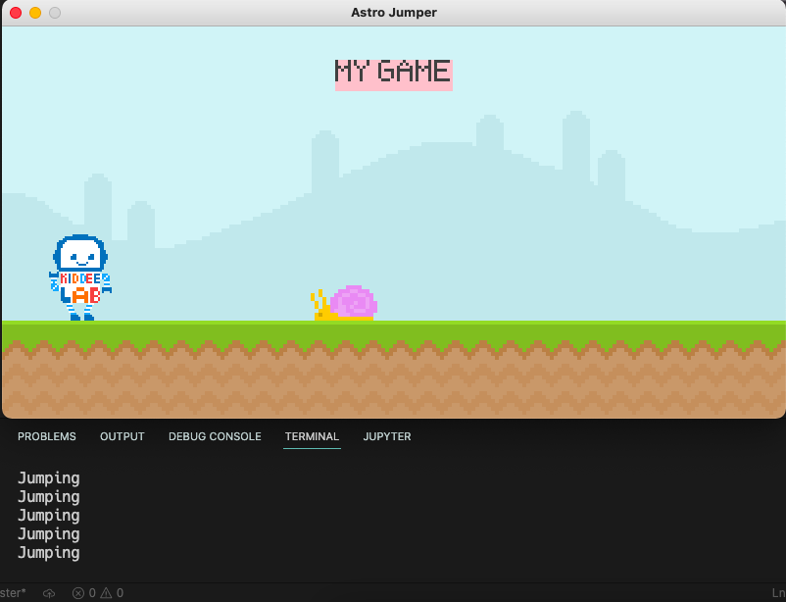

Slide 95
Makes game detect input
import pygame
from sys import exit
pygame.init()
screen = pygame.display.set_mode((800,400))
pygame.display.set_caption(‘Astro Jumper’)
clock = pygame.time.Clock()
loaded_font = pygame.font.Font(‘font/Pixeltype.ttf’,50)
sky_surf = pygame.image.load(‘graphics/sky.png’).convert_alpha()
ground_surf = pygame.image.load(‘graphics/ground.png’).convert_alpha()
text_surf = loaded_font.render(‘MY GAME’, False, ‘Black’)

Slide 96
sky_surf = pygame.image.load(‘graphics/sky.png’).convert_alpha()
ground_surf = pygame.image.load(‘graphics/ground.png’).convert_alpha()
text_surf = loaded_font.render('MY GAME', False, (64,64,64))
text_rect = text_surf.get_rect(center = (400,50))
snail_surf = pygame.image.load('graphics/snail/snail1.png').convert_alpha()
snail_rect = snail_surf.get_rect(midbottom = (80,300))
player_surf = pygame.image.load().convert_alpha()
player_rect = player_surf.get_rect(midbottom = (80,300))

Slide 97
while True:
for event in pygame.event.get():
if event.type == pygame.QUIT:
pygame.quit()
exit()
if event.type == pygame.KEYDOWN:
if event.key == pygame.K_SPACE:
print(‘Jumping’)
screen.blit(sky_surf,(0,0))
screen.blit(ground_surf,(0,300))
pygame.draw.rect(screen,’Pink’,text_rect)
screen.blit(text_surf,(300,50))
snail_rect.x -= 5
if snail__rect.right < -5: snail_rect.left = 800
screen.blit(snail_surf,snail_rect)
screen.blit(player_surf,player_rect)

Slide 98
if player_rect.colliderect(snail_rect):
print(‘collide’)
pygame.display.update()
clock.tick(60)

Slide 99
Exercise 10
Make the Player goes down by adding variable name ‘gravity’ to ‘player_rect.y’
Also make the Player jump when pressing space bar
Hint: use ‘gravity’ variable
Make the Player stop from falling at the ground

Slide 100
Gravity properties
The long player stay in the air, the more gravity the player has
In the nutshell, the longer you fall, the faster you are

Slide 101
Exercise 10: Answer
Make the Player goes down by adding variable name ‘gravity’ to ‘player_rect.y’
Also make the Player jump when pressing space bar
Hint: use ‘gravity’ variable
Make the Player stop from falling at the ground

Slide 102
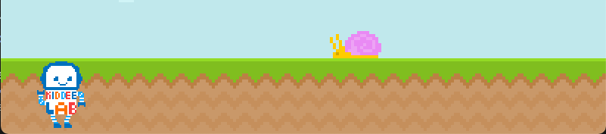
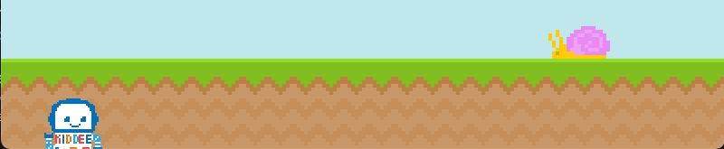

Slide 103
import pygame
from sys import exit
pygame.init()
screen = pygame.display.set_mode((800,400))
pygame.display.set_caption(‘Astro Jumper’)
clock = pygame.time.Clock()
loaded_font = pygame.font.Font(‘font/Pixeltype.ttf’,50)
sky_surf = pygame.image.load(‘graphics/sky.png’).convert_alpha()
ground_surf = pygame.image.load(‘graphics/ground.png’).convert_alpha()
text_surf = loaded_font.render('MY GAME', False, (64,64,64))
text_rect = text_surf.get_rect(center = (400,50))

Slide 104
snail_surf = pygame.image.load('graphics/snail/snail1.png').convert_alpha()
snail_rect = snail_surf.get_rect(midbottom = (80,300))
player_surf = pygame.image.load().convert_alpha()
player_rect = player_surf.get_rect(midbottom = (80,300))
gravity = 0

Slide 105
while True:
for event in pygame.event.get():
if event.type == pygame.QUIT:
pygame.quit()
exit()
if event.type == pygame.KEYDOWN:
if event.key == pygame.K_SPACE:
print(‘Jumping’)
screen.blit(sky_surf,(0,0))
screen.blit(ground_surf,(0,300))
pygame.draw.rect(screen,’Pink’,text_rect)
screen.blit(text_surf,(300,50))
snail_rect.x -= 5
if snail__rect.right < -5: snail_rect.left = 800
screen.blit(snail_surf,snail_rect)

Slide 106
# Player
gravity += 1
player_rect.y += gravity
screen.blit(player_surf,player_rect)
if player_rect.colliderect(snail_rect):
print(‘collide’)
pygame.display.update()
clock.tick(60)

Slide 107
Exercise 10: Answer
Make the Player goes down by adding variable name ‘gravity’ to ‘player_rect.y’
Also make the Player jump when pressing space bar
Hint: use ‘gravity’ variable
Make the Player stop from falling at the ground

Slide 108
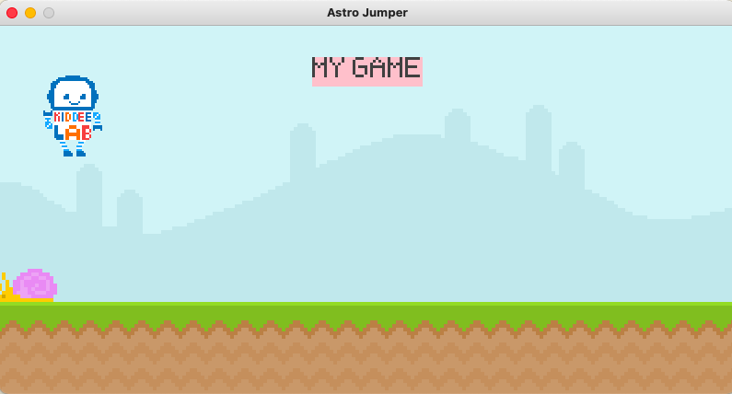

Slide 109
import pygame
from sys import exit
pygame.init()
screen = pygame.display.set_mode((800,400))
pygame.display.set_caption(‘Astro Jumper’)
clock = pygame.time.Clock()
loaded_font = pygame.font.Font(‘font/Pixeltype.ttf’,50)
sky_surf = pygame.image.load(‘graphics/sky.png’).convert_alpha()
ground_surf = pygame.image.load(‘graphics/ground.png’).convert_alpha()
text_surf = loaded_font.render('MY GAME', False, (64,64,64))
text_rect = text_surf.get_rect(center = (400,50))

Slide 110
snail_surf = pygame.image.load('graphics/snail/snail1.png').convert_alpha()
snail_rect = snail_surf.get_rect(midbottom = (80,300))
player_surf = pygame.image.load().convert_alpha()
player_rect = player_surf.get_rect(midbottom = (80,300))
gravity = 0

Slide 111
while True:
for event in pygame.event.get():
if event.type == pygame.QUIT:
pygame.quit()
exit()
if event.type == pygame.KEYDOWN:
if event.key == pygame.K_SPACE:
gravity -= 20
screen.blit(sky_surf,(0,0))
screen.blit(ground_surf,(0,300))
pygame.draw.rect(screen,’Pink’,text_rect)
screen.blit(text_surf,(300,50))
snail_rect.x -= 5
if snail__rect.right < -5: snail_rect.left = 800
screen.blit(snail_surf,snail_rect)

Slide 112
# Player
gravity += 1
player_rect.y += gravity
screen.blit(player_surf,player_rect)
if player_rect.colliderect(snail_rect):
print(‘collide’)
pygame.display.update()
clock.tick(60)

Slide 113
Exercise 10: Answer
Make the Player goes down by adding variable name ‘gravity’ to ‘player_rect.y’
Also make the Player jump when pressing space bar
Hint: use ‘gravity’ variable
Make the Player stop from falling from the ground and also make the jump when he’s only on the ground

Slide 115
import pygame
from sys import exit
pygame.init()
screen = pygame.display.set_mode((800,400))
pygame.display.set_caption(‘Astro Jumper’)
clock = pygame.time.Clock()
loaded_font = pygame.font.Font(‘font/Pixeltype.ttf’,50)
sky_surf = pygame.image.load(‘graphics/sky.png’).convert_alpha()
ground_surf = pygame.image.load(‘graphics/ground.png’).convert_alpha()
text_surf = loaded_font.render('MY GAME', False, (64,64,64))
text_rect = text_surf.get_rect(center = (400,50))

Slide 116
snail_surf = pygame.image.load('graphics/snail/snail1.png').convert_alpha()
snail_rect = snail_surf.get_rect(midbottom = (80,300))
player_surf = pygame.image.load().convert_alpha()
player_rect = player_surf.get_rect(midbottom = (80,300))
gravity = 0

Slide 117
while True:
for event in pygame.event.get():
if event.type == pygame.QUIT:
pygame.quit()
exit()
if event.type == pygame.KEYDOWN:
if event.key == pygame.K_SPACE and player_rect.bottom >= 300:
gravity = -20
screen.blit(sky_surf,(0,0))
screen.blit(ground_surf,(0,300))
pygame.draw.rect(screen,’Pink’,text_rect)
screen.blit(text_surf,(300,50))
snail_rect.x -= 5
if snail__rect.right < -5: snail_rect.left = 800
screen.blit(snail_surf,snail_rect)

Slide 118
# Player
gravity += 1
player_rect.y += gravity
if player_rect.bottom > 300:
player_rect.bottom = 300
gravity = 0
screen.blit(player_surf,player_rect)
if player_rect.colliderect(snail_rect):
print(‘collide’)
pygame.display.update()
clock.tick(60)

Slide 119
Chapter 7
Gamestate

Slide 120
Game state properties
If game state active then we can play the game
If game state is not active (or game over) make the screen yellow
When the game is restarted reset the snail movement

Slide 121
import pygame
from sys import exit
pygame.init()
screen = pygame.display.set_mode((800,400))
pygame.display.set_caption(‘Astro Jumper’)
clock = pygame.time.Clock()
loaded_font = pygame.font.Font(‘font/Pixeltype.ttf’,50)
sky_surf = pygame.image.load(‘graphics/sky.png’).convert_alpha()
ground_surf = pygame.image.load(‘graphics/ground.png’).convert_alpha()
text_surf = loaded_font.render('MY GAME', False, (64,64,64))
text_rect = text_surf.get_rect(center = (400,50))

Slide 122
snail_surf = pygame.image.load('graphics/snail/snail1.png').convert_alpha()
snail_rect = snail_surf.get_rect(midbottom = (80,300))
player_surf = pygame.image.load().convert_alpha()
player_rect = player_surf.get_rect(midbottom = (80,300))
gravity = 0
game_active = 0

Slide 123
while True:
for event in pygame.event.get():
if event.type == pygame.QUIT:
pygame.quit()
exit()
if game_active:
if event.type == pygame.KEYDOWN:
if event.key == pygame.K_SPACE and player_rect.bottom >= 300:
gravity -= 20
else:
if event.type == pygame.KEYDOWN and event.key == pygame.K_SPACE:
game_active == True
snail_rect.x = 800

Slide 124
if game_active:
screen.blit(sky_surf,(0,0))
screen.blit(ground_surf,(0,300))
pygame.draw.rect(screen,’Pink’,text_rect)
screen.blit(text_surf,(300,50))
snail_rect.x -= 5
if snail__rect.right < -5: snail_rect.left = 800
screen.blit(snail_surf,snail_rect)
# Player
gravity += 1
player_rect.y += gravity
if player_rect.bottom > 300:
player_rect.bottom = 300
gravity = 0
screen.blit(player_surf,player_rect)
if player_rect.colliderect(snail_rect):
print(‘collide’)

Slide 125
if player_rect.colliderect(snail_rect):
print(‘collide’)
else:
screen.fill(‘Red’)
pygame.display.update()
clock.tick(60)

Slide 126
Chapter 8
Display Score

Slide 127
Display score properties
Create a timer and make the Score depend on time
Update score on every frame when you are alive
Reset the score every time the game is restart

Slide 128
Display score properties
Create a timer and make the Score depend on time
Update score on every frame when you are alive
Reset the score every time the game is restart

Slide 129
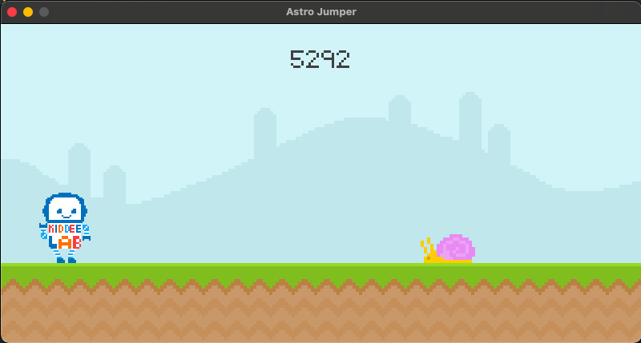

Slide 130
import pygame
from sys import exit
display_score():
current_time = pygame.time.get_tick()
score_surf = loaded_font.render(f’{current_time}’,False,(64,64,64))
score_rect = score_surf.get_rect(center = (400,50))
score.blit(score_surf,score_rect)
pygame.init()
screen = pygame.display.set_mode((800,400))
pygame.display.set_caption(‘Astro Jumper’)
clock = pygame.time.Clock()
loaded_font = pygame.font.Font(‘font/Pixeltype.ttf’,50)
sky_surf = pygame.image.load(‘graphics/sky.png’).convert_alpha()
ground_surf = pygame.image.load(‘graphics/ground.png’).convert_alpha()

Slide 131
# text_surf = loaded_font.render('MY GAME', False, (64,64,64))
# text_rect = text_surf.get_rect(center = (400,50))
snail_surf = pygame.image.load('graphics/snail/snail1.png').convert_alpha()
snail_rect = snail_surf.get_rect(midbottom = (80,300))
player_surf = pygame.image.load().convert_alpha()
player_rect = player_surf.get_rect(midbottom = (80,300))
gravity = 0
game_active = 0

Slide 132
while True:
for event in pygame.event.get():
if event.type == pygame.QUIT:
pygame.quit()
exit()
if game_active:
if event.type == pygame.KEYDOWN:
if event.key == pygame.K_SPACE and player_rect.bottom >= 300:
gravity -= 20
else:
if event.type == pygame.KEYDOWN and event.key == pygame.K_SPACE:
game_active == True
snail_rect.left = 800

Slide 133
if game_active:
screen.blit(sky_surf,(0,0))
screen.blit(ground_surf,(0,300))
display_score()
# pygame.draw.rect(screen,’Pink’,text_rect)
# screen.blit(text_surf,(300,50))
snail_rect.x -= 5
if snail__rect.right < -5: snail_rect.left = 800
screen.blit(snail_surf,snail_rect)
# Player
gravity += 1
player_rect.y += gravity
if player_rect.bottom > 300:
player_rect.bottom = 300
gravity = 0
screen.blit(player_surf,player_rect)
if player_rect.colliderect(snail_rect):
print(‘collide’)

Slide 134
if player_rect.colliderect(snail_rect):
print(‘collide’)
else:
screen.fill(‘Red’)
pygame.display.update()
clock.tick(60)

Slide 135
Display score properties
Create a timer and make the Score depend on time
Update score on every frame when you are alive
Reset the score every time the game is restart

Slide 136
import pygame
from sys import exit
display_score():
current_time = pygame.time.get_tick() - start_time
score_surf = loaded_font.render(f’{current_time}’,False,(64,64,64))
score_rect = score_surf.get_rect(center = (400,50))
score.blit(score_surf,score_rect)
pygame.init()
screen = pygame.display.set_mode((800,400))
pygame.display.set_caption(‘Astro Jumper’)
clock = pygame.time.Clock()
loaded_font = pygame.font.Font(‘font/Pixeltype.ttf’,50)
sky_surf = pygame.image.load(‘graphics/sky.png’).convert_alpha()
ground_surf = pygame.image.load(‘graphics/ground.png’).convert_alpha()

Slide 137
snail_surf = pygame.image.load('graphics/snail/snail1.png').convert_alpha()
snail_rect = snail_surf.get_rect(midbottom = (80,300))
player_surf = pygame.image.load().convert_alpha()
player_rect = player_surf.get_rect(midbottom = (80,300))
gravity = 0
game_active = 0
start_time = 0

Slide 138
while True:
for event in pygame.event.get():
if event.type == pygame.QUIT:
pygame.quit()
exit()
if game_active:
if event.type == pygame.KEYDOWN:
if event.key == pygame.K_SPACE and player_rect.bottom >= 300:
gravity -= 20
else:
if event.type == pygame.KEYDOWN and event.key == pygame.K_SPACE:
game_active == True
snail_rect.left = 800
start_time = pygame.time.get_ticks()

Slide 139
if game_active:
screen.blit(sky_surf,(0,0))
screen.blit(ground_surf,(0,300))
display_score()
snail_rect.x -= 5
if snail__rect.right < -5: snail_rect.left = 800
screen.blit(snail_surf,snail_rect)
# Player
gravity += 1
player_rect.y += gravity
if player_rect.bottom > 300:
player_rect.bottom = 300
gravity = 0
screen.blit(player_surf,player_rect)
if player_rect.colliderect(snail_rect):
print(‘collide’)

Slide 140
if player_rect.colliderect(snail_rect):
print(‘collide’)
else:
screen.fill(‘Red’)
pygame.display.update()
clock.tick(60)

Slide 141
Exercise 11
Make the score start slowly from 1,2,3,...

Slide 142
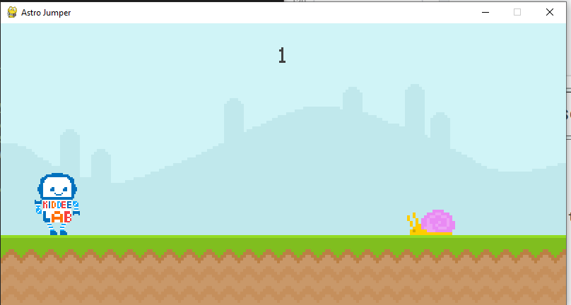

Slide 143
import pygame
from sys import exit
display_score():
current_time = int(pygame.time.get_tick()/1000 - start_time)
score_surf = loaded_font.render(f’{current_time}’,False,(64,64,64))
score_rect = score_surf.get_rect(center = (400,50))
score.blit(score_surf,score_rect)
pygame.init()
screen = pygame.display.set_mode((800,400))
pygame.display.set_caption(‘Astro Jumper’)
clock = pygame.time.Clock()
loaded_font = pygame.font.Font(‘font/Pixeltype.ttf’,50)
Exercise 11: Answer

Slide 144
sky_surf = pygame.image.load(‘graphics/sky.png’).convert_alpha()
ground_surf = pygame.image.load(‘graphics/ground.png’).convert_alpha()
snail_surf = pygame.image.load('graphics/snail/snail1.png').convert_alpha()
snail_rect = snail_surf.get_rect(midbottom = (80,300))
player_surf = pygame.image.load().convert_alpha()
player_rect = player_surf.get_rect(midbottom = (80,300))
gravity = 0
game_active = 0
start_time = 0

Slide 145
while True:
for event in pygame.event.get():
if event.type == pygame.QUIT:
pygame.quit()
exit()
if game_active:
if event.type == pygame.KEYDOWN:
if event.key == pygame.K_SPACE and player_rect.bottom >= 300:
gravity -= 20
else:
if event.type == pygame.KEYDOWN and event.key == pygame.K_SPACE:
game_active == True
snail_rect.left = 800
start_time = int(pygame.time.get_ticks()/1000)

Slide 146
if game_active:
screen.blit(sky_surf,(0,0))
screen.blit(ground_surf,(0,300))
display_score()
snail_rect.x -= 5
if snail__rect.right < -5: snail_rect.left = 800
screen.blit(snail_surf,snail_rect)
# Player
gravity += 1
player_rect.y += gravity
if player_rect.bottom > 300:
player_rect.bottom = 300
gravity = 0
screen.blit(player_surf,player_rect)
if player_rect.colliderect(snail_rect):
print(‘collide’)

Slide 147
Chapter 9
Intro screen

Slide 148
Intro screen
For VS Code user, some part of the code need to be close, since we don’t need them now
For IDLE user, we will some code for now

Slide 149
import pygame
from sys import exit
display_score():...
pygame.init()
screen = pygame.display.set_mode((800,400))
pygame.display.set_caption(‘Astro Jumper’)
clock = pygame.time.Clock()
loaded_font = pygame.font.Font(‘font/Pixeltype.ttf’,50)
sky_surf = pygame.image.load(‘graphics/sky.png’).convert_alpha()
ground_surf = pygame.image.load(‘graphics/ground.png’).convert_alpha()
snail_surf = pygame.image.load('graphics/snail/snail1.png').convert_alpha()
snail_rect = snail_surf.get_rect(midbottom = (80,300))

Slide 150
player_surf = pygame.image.load().convert_alpha()
player_rect = player_surf.get_rect(midbottom = (80,300))
gravity = 0
game_active = 0
start_time = 0

Slide 151
while True:
for event in pygame.event.get(): ...
if game_active: ...
else:
screen.fill(‘Red’)
pygame.display.update()
clock.tick(60)

Slide 152
Intro screen properties
Image ‘Standing.png’ with the scale times 2 will be at the center of the screen
Also, there are text = ‘Astro Jumper’ on top of the image and text = ‘Press Spacebar to run’ at the bottom of the image

Slide 153
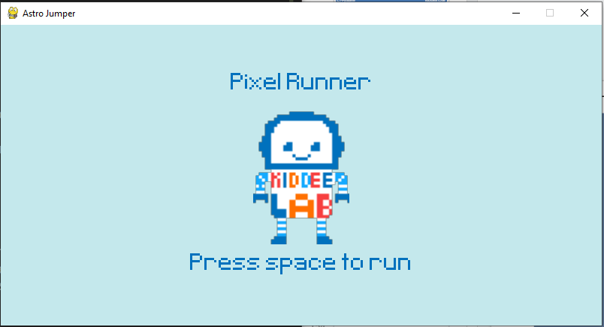

Slide 154
Syntax: transform
pygame.transform.scale(s,si) s, si = Surface, Size | Resize the Surface to a new size as (width, height)
pygame.transform.scale2x(s) s = Surface | Resize the Surface size to x2
pygame.transform.rotozoom(s,a,sc) s,a,sc = Surface, Angle, Scale | Filtered scale and rotation

Slide 155
Intro screen properties
Image ‘Standing.png’ with the scale times 2 will be at the center of the screen
Also, there are text = ‘Astro Jumper’ on top of the image and text = ‘Press Spacebar to run’ at the bottom of the image

Slide 156
import pygame
from sys import exit
display_score():...
pygame.init()
screen = pygame.display.set_mode((800,400))
pygame.display.set_caption(‘Astro Jumper’)
clock = pygame.time.Clock()
loaded_font = pygame.font.Font(‘font/Pixeltype.ttf’,50)
sky_surf = pygame.image.load(‘graphics/sky.png’).convert_alpha()
ground_surf = pygame.image.load(‘graphics/ground.png’).convert_alpha()
snail_surf = pygame.image.load('graphics/snail/snail1.png').convert_alpha()
snail_rect = snail_surf.get_rect(midbottom = (80,300))

Slide 157
player_surf = pygame.image.load().convert_alpha()
player_rect = player_surf.get_rect(midbottom = (80,300))
gravity = 0
game_active = 0
start_time = 0
# Intro screen
player_stand = pygame.image.load(‘graphics/Player
/Standing.png’).convert_alpha()
player_stand = pygame.transform.rotozoom(player_stand,0,2)
player_stand_rect = player_stand.get_rect(center = (400,200))

Slide 158
while True:
for event in pygame.event.get(): ...
if game_active: ...
else:
screen.fill((196,232,236))
screen.blit(player_stand,player_stand_rect)
pygame.display.update()
clock.tick(60)

Slide 159
Intro screen properties
Image ‘Standing.png’ with the scale times 2 will be at the center of the screen
Also, there are text = ‘Astro Jumper’ on top of the image and text = ‘Press Spacebar to run’ at the bottom of the image

Slide 160
import pygame
from sys import exit
display_score():...
pygame.init()
screen = pygame.display.set_mode((800,400))
pygame.display.set_caption(‘Astro Jumper’)
clock = pygame.time.Clock()
loaded_font = pygame.font.Font(‘font/Pixeltype.ttf’,50)
sky_surf = pygame.image.load(‘graphics/sky.png’).convert_alpha()
ground_surf = pygame.image.load(‘graphics/ground.png’).convert_alpha()
snail_surf = pygame.image.load('graphics/snail/snail1.png').convert_alpha()
snail_rect = snail_surf.get_rect(midbottom = (80,300))

Slide 161
player_surf = pygame.image.load().convert_alpha()
player_rect = player_surf.get_rect(midbottom = (80,300))
gravity = 0
game_active = 0
start_time = 0
# Intro screen
player_stand = pygame.image.load(‘graphics/Player
/Standing.png’).convert_alpha()
player_stand = pygame.transform.rotozoom(player_stand,0,2)
player_stand_rect = player_stand.get_rect(center = (400,200))
game_name = loaded_font.render('Pixel Runner',False,(0,113,189))
game_name_rect = game_name.get_rect(center = (400,80))
game_message = loaded_font.render('Press space to run',False,(0,113,189))
game_message_rect = game_message.get_rect(center = (400,320))

Slide 162
while True:
for event in pygame.event.get(): ...
if game_active: ...
else:
screen.fill((196,232,236))
screen.blit(player_stand,player_stand_rect)
screen.blit(game_name,game_name_rect)
screen.blit(game_message,game_message_rect)
pygame.display.update()
clock.tick(60)

Slide 163
Intro screen properties

Slide 164
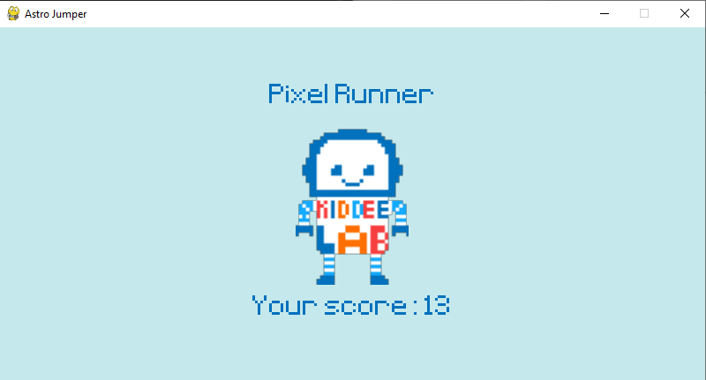

Slide 165
import pygame
from sys import exit
def display_score():
current_time = int(pygame.time.get_ticks()/1000 - start_time)
score_surf = loaded_font.render(f'{current_time}',False,(64,64,64))
score_rect = score_surf.get_rect(center = (400,50))
screen.blit(score_surf,score_rect)
return current_time
pygame.init()
screen = pygame.display.set_mode((800,400))
pygame.display.set_caption(‘Astro Jumper’)
clock = pygame.time.Clock()
loaded_font = pygame.font.Font(‘font/Pixeltype.ttf’,50)
sky_surf = pygame.image.load(‘graphics/sky.png’).convert_alpha()
ground_surf = pygame.image.load(‘graphics/ground.png’).convert_alpha()
snail_surf = pygame.image.load('graphics/snail/snail1.png').convert_alpha()
snail_rect = snail_surf.get_rect(midbottom = (80,300))

Slide 166
player_surf = pygame.image.load().convert_alpha()
player_rect = player_surf.get_rect(midbottom = (80,300))
gravity = 0
game_active = 0
start_time = 0
score = 0
# Intro screen
player_stand = pygame.image.load(‘graphics/Player
/Standing.png’).convert_alpha()
player_stand = pygame.transform.rotozoom(player_stand,0,2)
player_stand_rect = player_stand.get_rect(center = (400,200))
game_name = loaded_font.render('Pixel Runner',False,(0,113,189))
game_name_rect = game_name.get_rect(center = (400,80))
game_message = loaded_font.render('Press space to run',False,(0,113,189))
game_message_rect = game_message.get_rect(center = (400,320))

Slide 167
while True:
for event in pygame.event.get(): ...
if game_active: ...
else:
screen.fill((196,232,236))
screen.blit(player_stand,player_stand_rect)
score_message = loaded_font.render(f'Your score: {score}',False,(0,113,189))
score_message_rect = score_message.get_rect(center = (400,320))
screen.blit(game_name,game_name_rect)
if score == 0:
screen.blit(game_message,game_message_rect)
else:
screen.blit(score_message,score_message_rect)
pygame.display.update()
clock.tick(60)

Slide 168
Chapter 10
Better Enemy

Slide 169
Enemy properties
Better spawn logic (using Timer)
Spawn multiple kind of enemy so that player need to choose between jumping or walking

Slide 170
Timer properties
Create a custom user event that is triggered in certain time intervals
Tell pygame to trigger that event continuously
Add code in the event loop

Slide 171
Syntax: Event and Timer
pygame.USEREVENT + N N = Integer number | Add a user event *Integer number needed to be added every time we have user event so that there is no event conflict
pygame.time.set_timer(e, m) e, m = Event, millisecond | Set an event to occur every given number

Slide 172
import pygame
from sys import exit
def display_score():
current_time = int(pygame.time.get_ticks()/1000 - start_time)
score_surf = loaded_font.render(f'{current_time}',False,(64,64,64))
score_rect = score_surf.get_rect(center = (400,50))
screen.blit(score_surf,score_rect)
return current_time
pygame.init()
screen = pygame.display.set_mode((800,400))
pygame.display.set_caption(‘Astro Jumper’)
clock = pygame.time.Clock()
loaded_font = pygame.font.Font(‘font/Pixeltype.ttf’,50)
sky_surf = pygame.image.load(‘graphics/sky.png’).convert_alpha()
ground_surf = pygame.image.load(‘graphics/ground.png’).convert_alpha()
snail_surf = pygame.image.load('graphics/snail/snail1.png').convert_alpha()
snail_rect = snail_surf.get_rect(midbottom = (80,300))

Slide 173
player_surf = pygame.image.load().convert_alpha()
player_rect = player_surf.get_rect(midbottom = (80,300))
gravity = 0
game_active = 0
start_time = 0
score = 0
# Intro screen
player_stand = pygame.image.load(‘graphics/Player
/Standing.png’).convert_alpha()
player_stand = pygame.transform.rotozoom(player_stand,0,2)
player_stand_rect = player_stand.get_rect(center = (400,200))
game_name = loaded_font.render('Pixel Runner',False,(0,113,189))
game_name_rect = game_name.get_rect(center = (400,80))
game_message = loaded_font.render('Press space to run',False,(0,113,189))
game_message_rect = game_message.get_rect(center = (400,320))
# Timer
obstacle_timer = pygame.USEREVENT + 1
pygame.time.set_timer(obstacle_time,900)

Slide 174
while True:
for event in pygame.event.get():
if event.type == pygame.QUIT:
pygame.quit()
exit()
if game_active:
if event.type == pygame.KEYDOWN:
if event.key == pygame.K_SPACE and player_rect.bottom >= 300:
gravity -= 20
if event.type == obstacle_timer:
print('Test')
else:
if event.type == pygame.KEYDOWN and event.key == pygame.K_SPACE:
game_active = True
snail_rect.left = 800
start_time = int(pygame.time.get_ticks()/1000)

Slide 175
if game_active:
screen.blit(sky_surf,(0,0))
screen.blit(ground_surf,(0,300))
score = display_score()
# Player
gravity += 1
player_rect.y += gravity
if player_rect.bottom > 300:
player_rect.bottom = 300
gravity = 0
screen.blit(player_surf,player_rect)
if player_rect.colliderect(snail_rect):
game_active = False

Slide 176
else:
screen.fill((196,232,236))
screen.blit(player_stand,player_stand_rect)
score_message = loaded_font.render(f'Your score: {score}',False,(0,113,189))
score_message_rect = score_message.get_rect(center = (400,320))
screen.blit(game_name,game_name_rect)
if score == 0:
screen.blit(game_message,game_message_rect)
else:
screen.blit(score_message,score_message_rect)
pygame.display.update()
clock.tick(60)

Slide 177
Obstacle logic
Create a list of obstacle rectangles
Everytime the timer triggers, a new rectangle is added to that list
Move every rectangle in that list to the left on every frame (By using function)

Slide 178
import pygame
from sys import exit
from random import randint
def display_score(): . . .
def obstacle_movement(obstacle_list):
if obstacle_list:
for obstacle_rect in obstacle_list:
obstacle_rect.x -= 5
screen.blit(snail_surf,obstacle_rect)
return obstacle_list
return [] #3
pygame.init()
screen = pygame.display.set_mode((800,400))
pygame.display.set_caption('Astro Jumper')
clock = pygame.time.Clock()
loaded_font = pygame.font.Font('font/Pixeltype.ttf',50)

Slide 179
sky_surf = pygame.image.load('graphics/sky.png').convert_alpha()
ground_surf = pygame.image.load('graphics/ground.png').convert_alpha()
#Obsatacle
snail_surf = pygame.image.load('graphics/snail/snail1.png').convert_alpha()
snail_rect = snail_surf.get_rect(midbottom = (850,300))
obstacle_rect_list = [] #1
player_surf = pygame.image.load('graphics/Player/Walking1.png').convert_alpha()
player_rect = player_surf.get_rect(midbottom = (80,300))
gravity = 0
game_active = False
start_time = 0
score = 0

Slide 180
# Intro screen
player_stand = pygame.image.load('graphics/Player/Standing.png').convert_alpha()
player_stand = pygame.transform.rotozoom(player_stand,0,2)
player_stand_rect = player_stand.get_rect(center = (400,200))
game_name = loaded_font.render('Pixel Runner',False,(0,113,189))
game_name_rect = game_name.get_rect(center = (400,80))
game_message = loaded_font.render('Press space to run',False,(0,113,189))
game_message_rect = game_message.get_rect(center = (400,320))
# Timer
obstacle_timer = pygame.USEREVENT + 1
pygame.time.set_timer(obstacle_timer,1500)

Slide 181
while True:
for event in pygame.event.get():
if event.type == pygame.QUIT:
pygame.quit()
exit()
if game_active:
if event.type == pygame.KEYDOWN:
if event.key == pygame.K_SPACE and player_rect.bottom >= 300:
gravity -= 20
if event.type == obstacle_timer:
obstacle_rect_list.append(snail_surf.get_rect(midbottom = (randint(900,1100),300))) #2
else:
if event.type == pygame.KEYDOWN and event.key == pygame.K_SPACE:
game_active = True
snail_rect.left = 800
start_time = int(pygame.time.get_ticks()/1000)

Slide 182
if game_active:
screen.blit(sky_surf,(0,0))
screen.blit(ground_surf,(0,300))
score = display_score()
# snail_rect.x -= 5
# if snail_rect.right < -5: snail_rect.left = 800
# screen.blit(snail_surf,snail_rect)
# Player
gravity += 1
player_rect.y += gravity
if player_rect.bottom > 300:
player_rect.bottom = 300
gravity = 0
screen.blit(player_surf,player_rect)
# Obstacle movement
obstacle_rect_list = obstacle_movement(obstacle_rect_list)#3

Slide 183
# Collision
if player_rect.colliderect(snail_rect):
game_active = False
else:
screen.fill((196,232,236))
screen.blit(player_stand,player_stand_rect)
score_message = loaded_font.render(f'Your score: {score}',False,(0,113,189))
score_message_rect = score_message.get_rect(center = (400,320))
screen.blit(game_name,game_name_rect)
if score == 0:
screen.blit(game_message,game_message_rect)
else:
screen.blit(score_message,score_message_rect)
pygame.display.update()
clock.tick(60)

Slide 184
Obstacle logic
As you can see:
The rectangles that too far to the left need to be deleted (this will affected to our PC performance)
The collision doesn’t work
We only have snail obstacle

Slide 185
import pygame
from sys import exit
from random import randint
def display_score():
current_time = int(pygame.time.get_ticks()/1000 - start_time)
score_surf = loaded_font.render(f'{current_time}',False,(64,64,64))
score_rect = score_surf.get_rect(center = (400,50))
screen.blit(score_surf,score_rect)
return current_time

Slide 186
def obstacle_movement(obstacle_list):
if obstacle_list:
for obstacle_rect in obstacle_list:
obstacle_rect.x -= 5
if obstacle_rect.bottom == 300: screen.blit(snail_surf,obstacle_rect)
else: screen.blit(fly_surf,obstacle_rect)
new_obstacle_list = []
for obstacle in obstacle_list:
if obstacle.x > -100:
new_obstacle_list.append(obstacle)
return new_obstacle_list
else:
return []

Slide 187
def collisions(player,obstacles):
if obstacles:
for obstacle_rect in obstacles:
if player.colliderect(obstacle_rect): return False
return True
pygame.init()
screen = pygame.display.set_mode((800,400))
pygame.display.set_caption('Astro Jumper')
clock = pygame.time.Clock()
loaded_font = pygame.font.Font('font/Pixeltype.ttf',50)
sky_surf = pygame.image.load('graphics/sky.png').convert_alpha()
ground_surf = pygame.image.load('graphics/ground.png').convert_alpha()
#Obsatacle
snail_surf = pygame.image.load('graphics/snail/snail1.png').convert_alpha()
fly_surf = pygame.image.load('graphics/fly/fly1.png').convert_alpha()
obstacle_rect_list = []

Slide 188
player_surf = pygame.image.load('graphics/Player/Walking1.png').convert_alpha()
player_rect = player_surf.get_rect(midbottom = (80,300))
gravity = 0
game_active = False
start_time = 0
score = 0
# Intro screen
player_stand = pygame.image.load('graphics/Player/Standing.png').convert_alpha()
player_stand = pygame.transform.rotozoom(player_stand,0,2)
player_stand_rect = player_stand.get_rect(center = (400,200))
game_name = loaded_font.render('Pixel Runner',False,(0,113,189))
game_name_rect = game_name.get_rect(center = (400,80))
game_message = loaded_font.render('Press space to run',False,(0,113,189))
game_message_rect = game_message.get_rect(center = (400,320))

Slide 189
# Timer
obstacle_timer = pygame.USEREVENT + 1
pygame.time.set_timer(obstacle_timer,1500)
while True:
for event in pygame.event.get():
if event.type == pygame.QUIT:
pygame.quit()
exit()
if game_active:
if event.type == pygame.KEYDOWN:
if event.key == pygame.K_SPACE and player_rect.bottom >= 300:
gravity -= 20

Slide 190
if event.type == obstacle_timer:
if randint(0,2):
obstacle_rect_list.append(snail_surf.get_rect(midbottom = (randint(900,1100),300)))
else:
obstacle_rect_list.append(fly_surf.get_rect(bottomright = (randint(900,1100),200)))
else:
if event.type == pygame.KEYDOWN and event.key == pygame.K_SPACE:
game_active = True
start_time = int(pygame.time.get_ticks()/1000)

Slide 191
if game_active:
screen.blit(sky_surf,(0,0))
screen.blit(ground_surf,(0,300))
score = display_score()
# snail_rect.x -= 5
# if snail_rect.right < -5: snail_rect.left = 800
# screen.blit(snail_surf,snail_rect)
# Player
gravity += 1
player_rect.y += gravity
if player_rect.bottom > 300:
player_rect.bottom = 300
gravity = 0
screen.blit(player_surf,player_rect)
# Obstacle movement
obstacle_rect_list = obstacle_movement(obstacle_rect_list)

Slide 192
# Collision
game_active = collisions(player_rect,obstacle_rect_list)
else:
screen.fill((196,232,236))
screen.blit(player_stand,player_stand_rect)
score_message = loaded_font.render(f'Your score: {score}',False,(0,113,189))
score_message_rect = score_message.get_rect(center = (400,320))
screen.blit(game_name,game_name_rect)
obstacle_rect_list.clear()
player_rect.midbottom = (80,300)
player_gravity = 0

Slide 193
if score == 0:
screen.blit(game_message,game_message_rect)
else:
screen.blit(score_message,score_message_rect)
pygame.display.update()
clock.tick(60)

Slide 194
Chapter 11
Advance animation

Slide 195
How to animated
Use two image and switch it back and forth (using list)
Player animation
Walking
Jumping
Obstacle animation
Snail
Fly

Slide 196
How to animated
Use two image and switch it back and forth (using list)
Player animation
Walking
Jumping
Obstacle animation
Snail
Fly

Slide 197
import pygame
from sys import exit
from random import randint
def display_score(): . . .
def obstacle_movement(obstacle_list): . . .
def collisions(player,obstacles): . . .
def player_animation():
global player_surf, player_index
if player_rect.bottom < 300:
# Jump
player_surf = player_jump
else:
# Walk
player_index += 0.1
if player_index >= len(player_walk): player_index = 0
player_surf = player_walk[int(player_index)]

Slide 198
pygame.init()
screen = pygame.display.set_mode((800,400))
pygame.display.set_caption('Astro Jumper')
clock = pygame.time.Clock()
loaded_font = pygame.font.Font('font/Pixeltype.ttf',50)
sky_surf = pygame.image.load('graphics/sky.png').convert_alpha()
ground_surf = pygame.image.load('graphics/ground.png').convert_alpha()
#Obsatacle
snail_surf = pygame.image.load('graphics/snail/snail1.png').convert_alpha()
fly_surf = pygame.image.load('graphics/fly/fly1.png').convert_alpha()
obstacle_rect_list = []

Slide 199
player_walk_1 = pygame.image.load('graphics/Player/Walking1.png').convert_alpha()
player_walk_2 = pygame.image.load('graphics/Player/Walking2.png').convert_alpha()
player_walk = [player_walk_1,player_walk_2]
player_index = 0
player_jump = pygame.image.load('graphics/Player/Jumping.png').convert_alpha()
player_surf = player_walk[player_index]
player_rect = player_surf.get_rect(midbottom = (80,300))
gravity = 0
game_active = False
start_time = 0
score = 0

Slide 200
# Intro screen
player_stand = pygame.image.load('graphics/Player/Standing.png').convert_alpha()
player_stand = pygame.transform.rotozoom(player_stand,0,2)
player_stand_rect = player_stand.get_rect(center = (400,200))
game_name = loaded_font.render('Pixel Runner',False,(0,113,189))
game_name_rect = game_name.get_rect(center = (400,80))
game_message = loaded_font.render('Press space to run',False,(0,113,189))
game_message_rect = game_message.get_rect(center = (400,320))
# Timer
obstacle_timer = pygame.USEREVENT + 1
pygame.time.set_timer(obstacle_timer,1500)

Slide 201
while True:
for event in pygame.event.get():
if event.type == pygame.QUIT:
pygame.quit()
exit()
if game_active:
if event.type == pygame.KEYDOWN:
if event.key == pygame.K_SPACE and player_rect.bottom >= 300:
gravity -= 20
if event.type == obstacle_timer:
if randint(0,2):
obstacle_rect_list.append(snail_surf.get_rect(midbottom = (randint(900,1100),300)))
else:
obstacle_rect_list.append(fly_surf.get_rect(bottomright = (randint(900,1100),200)))

Slide 202
else:
if event.type == pygame.KEYDOWN and event.key == pygame.K_SPACE:
game_active = True
start_time = int(pygame.time.get_ticks()/1000)
if game_active:
screen.blit(sky_surf,(0,0))
screen.blit(ground_surf,(0,300))
score = display_score()
# Player
gravity += 1
player_rect.y += gravity
if player_rect.bottom > 300:
player_rect.bottom = 300
gravity = 0
player_animation()
screen.blit(player_surf,player_rect)

Slide 203
# Obstacle movement
obstacle_rect_list = obstacle_movement(obstacle_rect_list)
# Collision
game_active = collisions(player_rect,obstacle_rect_list)
else:
screen.fill((196,232,236))
screen.blit(player_stand,player_stand_rect)
obstacle_rect_list.clear()
player_rect.midbottom = (80,300)
player_gravity = 0
score_message = loaded_font.render(f'Your score: {score}',False,(0,113,189))
score_message_rect = score_message.get_rect(center = (400,320))
screen.blit(game_name,game_name_rect)

Slide 204
if score == 0:
screen.blit(game_message,game_message_rect)
else:
screen.blit(score_message,score_message_rect)
pygame.display.update()
clock.tick(60)

Slide 205
How to animated
Use two image and switch it back and forth (using list)
Player animation
Walking
Jumping
Obstacle animation
Snail
Fly

Slide 206
import pygame
from sys import exit
from random import randint
def display_score(): . . .
def obstacle_movement(obstacle_list): . . .
def collisions(player,obstacles): . . .
def player_animation(): . . .
pygame.init()
screen = pygame.display.set_mode((800,400))
pygame.display.set_caption('Astro Jumper')
clock = pygame.time.Clock()
loaded_font = pygame.font.Font('font/Pixeltype.ttf',50)
sky_surf = pygame.image.load('graphics/sky.png').convert_alpha()
ground_surf = pygame.image.load('graphics/ground.png').convert_alpha()

Slide 207
# Snail
snail_frame_1 = pygame.image.load('graphics/snail/snail1.png').convert_alpha()
snail_frame_2 = pygame.image.load('graphics/snail/snail2.png').convert_alpha()
snail_frames = [snail_frame_1,snail_frame_2]
snail_frame_index = 0
snail_surf = snail_frames[snail_frame_index]
# Fly
fly_frame_1 = pygame.image.load('graphics/fly/fly1.png').convert_alpha()
fly_frame_2 = pygame.image.load('graphics/fly/fly2.png').convert_alpha()
fly_frames = [fly_frame_1,fly_frame_2]
fly_frame_index = 0
fly_surf = fly_frames[fly_frame_index]
obstacle_rect_list = []

Slide 208
player_walk_1 = pygame.image.load('graphics/Player/Walking1.png').convert_alpha()
player_walk_2 = pygame.image.load('graphics/Player/Walking2.png').convert_alpha()
player_walk = [player_walk_1,player_walk_2]
player_index = 0
player_jump = pygame.image.load('graphics/Player/Jumping.png').convert_alpha()
player_surf = player_walk[player_index]
player_rect = player_surf.get_rect(midbottom = (80,300))
gravity = 0
game_active = False
start_time = 0
score = 0
# Intro screen
player_stand = pygame.image.load('graphics/Player/Standing.png').convert_alpha()
player_stand = pygame.transform.rotozoom(player_stand,0,2)
player_stand_rect = player_stand.get_rect(center = (400,200))

Slide 209
game_name = loaded_font.render('Pixel Runner',False,(0,113,189))
game_name_rect = game_name.get_rect(center = (400,80))
game_message = loaded_font.render('Press space to run',False,(0,113,189))
game_message_rect = game_message.get_rect(center = (400,320))
# Timer
obstacle_timer = pygame.USEREVENT + 1
pygame.time.set_timer(obstacle_timer,1500)
snail_animation_timer = pygame.USEREVENT + 2
pygame.time.set_timer(snail_animation_timer,500)
fly_animation_timer = pygame.USEREVENT + 3
pygame.time.set_timer(fly_animation_timer,200)

Slide 210
while True:
for event in pygame.event.get():
if event.type == pygame.QUIT:
pygame.quit()
exit()
if game_active:
if event.type == pygame.KEYDOWN:
if event.key == pygame.K_SPACE and player_rect.bottom >= 300:
gravity -= 20
if event.type == obstacle_timer:
if randint(0,2):
obstacle_rect_list.append(snail_surf.get_rect(midbottom = (randint(900,1100),300)))
else:
obstacle_rect_list.append(fly_surf.get_rect(bottomright = (randint(900,1100),200)))

Slide 211
if event.type == snail_animation_timer:
if snail_frame_index == 0: snail_frame_index = 1
else: snail_frame_index = 0
snail_surf = snail_frames[snail_frame_index]
if event.type == fly_animation_timer:
if fly_frame_index == 0: fly_frame_index = 1
else: fly_frame_index = 0
fly_surf = fly_frames[fly_frame_index]
else:
if event.type == pygame.KEYDOWN and event.key == pygame.K_SPACE:
game_active = True
start_time = int(pygame.time.get_ticks()/1000)

Slide 212
if game_active:
screen.blit(sky_surf,(0,0))
screen.blit(ground_surf,(0,300))
score = display_score()
# Player
gravity += 1
player_rect.y += gravity
if player_rect.bottom > 300:
player_rect.bottom = 300
gravity = 0
player_animation()
screen.blit(player_surf,player_rect)
# Obstacle movement
obstacle_rect_list = obstacle_movement(obstacle_rect_list)
# Collision
game_active = collisions(player_rect,obstacle_rect_list)

Slide 213
else:
screen.fill((196,232,236))
screen.blit(player_stand,player_stand_rect)
obstacle_rect_list.clear()
player_rect.midbottom = (80,300)
player_gravity = 0
score_message = loaded_font.render(f'Your score: {score}',False,(0,113,189))
score_message_rect = score_message.get_rect(center = (400,320))
screen.blit(game_name,game_name_rect)
if score == 0:
screen.blit(game_message,game_message_rect)
else:
screen.blit(score_message,score_message_rect)
pygame.display.update()
clock.tick(60)

Slide 214
Chapter 12
Sprite class

Slide 215
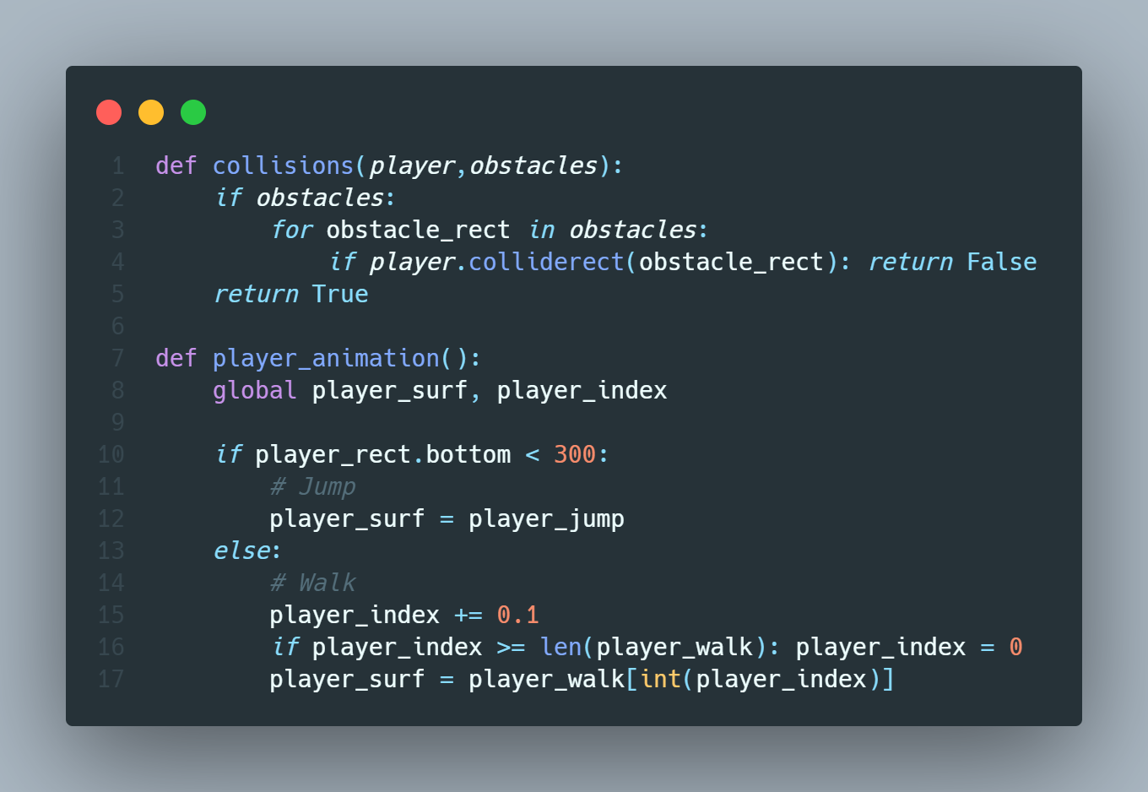
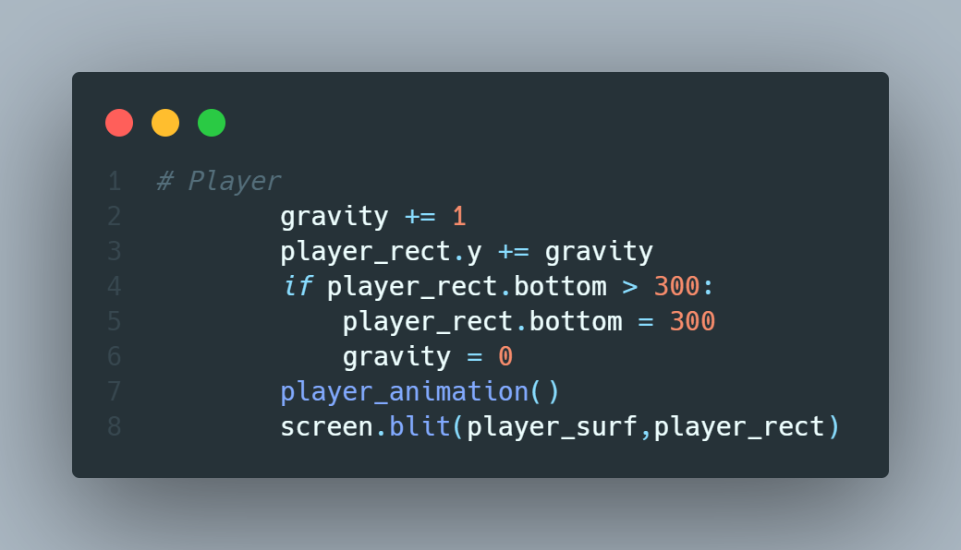
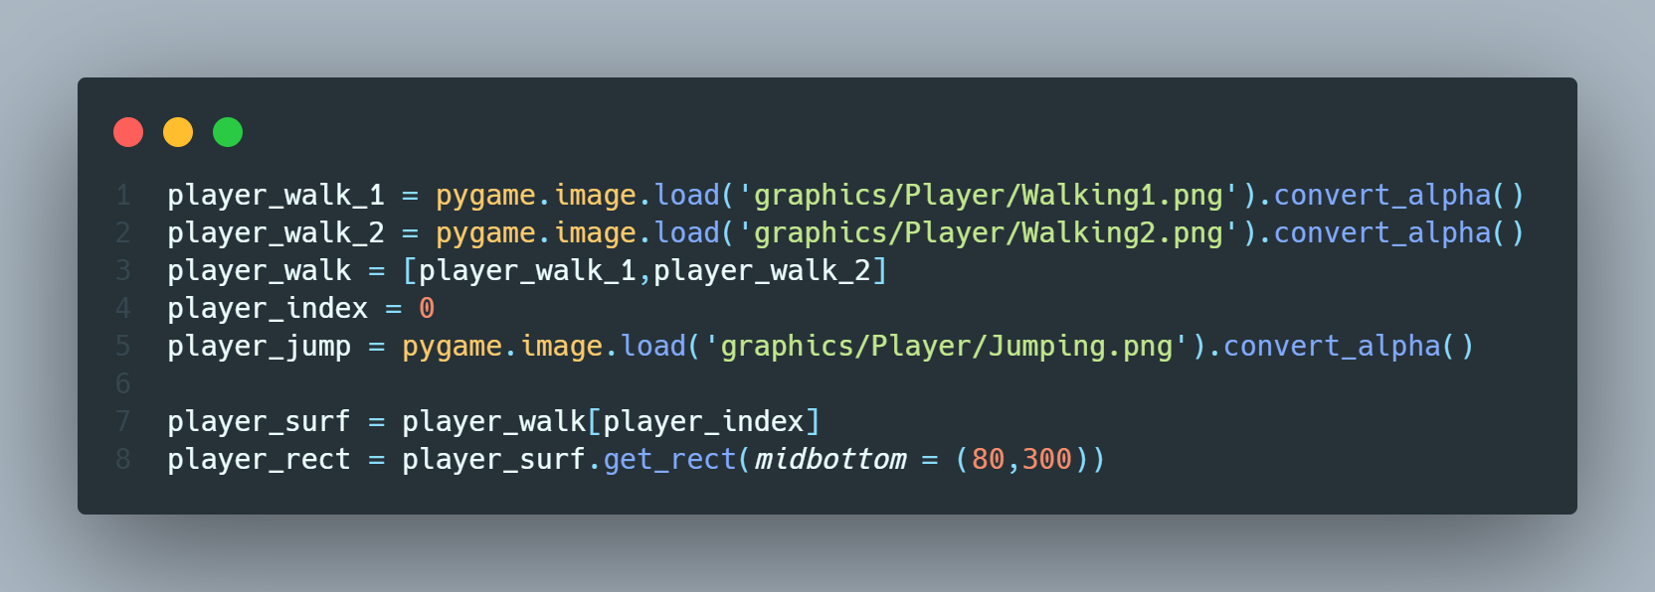
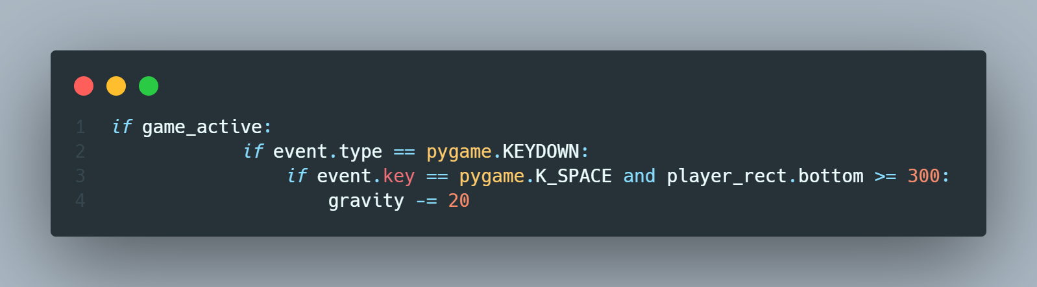
Why using sprite class?
Codes are separated

Slide 216
Why using sprite class?
Codes are separated
Hard to maintain when the game becomes more complex
Class can contain the related code together (ex. Player’s code)
Class (Sprite class) can contain rectangle, surface and it can be drawn and updated very easily

Slide 217
What need to be done?
Create a Sprite
Place Sprites in Group(Multiple sprites) or GroupSingle(Single sprite)
Draw/Update all Sprites in that group

Slide 218
Objective
Create a Class for the Player
Draw the Player
Add other related function to the Player
Create a Class for the Obstacle

Slide 219
Objective
Create a Class for the Player
Draw the Player
Add other related function to the Player
Create a Class for the Obstacle

Slide 220
import pygame
from sys import exit
from random import randint
class Player(pygame.sprite.Sprite):
def __init__(self):
super().__init__()
self.image = pygame.image.load('graphics/Player/Walking1.png').convert_alpha()
self.rect = self.image.get_rect(midbottom = (200,300))
def display_score(): . . .
def obstacle_movement(obstacle_list): . . .
def collisions(player,obstacles): . . .

Slide 221
pygame.init()
screen = pygame.display.set_mode((800,400))
pygame.display.set_caption('Astro Jumper')
clock = pygame.time.Clock()
loaded_font = pygame.font.Font('font/Pixeltype.ttf',50)
player = pygame.sprite.GroupSingle()
player.add(Player())
sky_surf = pygame.image.load('graphics/sky.png').convert_alpha()
ground_surf = pygame.image.load('graphics/ground.png').convert_alpha()
# Snail
snail_frame_1 = pygame.image.load('graphics/snail/snail1.png').convert_alpha()
snail_frame_2 = pygame.image.load('graphics/snail/snail2.png').convert_alpha()
snail_frames = [snail_frame_1,snail_frame_2]
snail_frame_index = 0
snail_surf = snail_frames[snail_frame_index]

Slide 222
# Fly
fly_frame_1 = pygame.image.load('graphics/fly/fly1.png').convert_alpha()
fly_frame_2 = pygame.image.load('graphics/fly/fly2.png').convert_alpha()
fly_frames = [fly_frame_1,fly_frame_2]
fly_frame_index = 0
fly_surf = fly_frames[fly_frame_index]
obstacle_rect_list = []
player_walk_1 = pygame.image.load('graphics/Player/Walking1.png').convert_alpha()
player_walk_2 = pygame.image.load('graphics/Player/Walking2.png').convert_alpha()
player_walk = [player_walk_1,player_walk_2]
player_index = 0
player_jump = pygame.image.load('graphics/Player/Jumping.png').convert_alpha()
player_surf = player_walk[player_index]
player_rect = player_surf.get_rect(midbottom = (80,300))

Slide 223
gravity = 0
game_active = False
start_time = 0
score = 0
# Intro screen
player_stand = pygame.image.load('graphics/Player/Standing.png').convert_alpha()
player_stand = pygame.transform.rotozoom(player_stand,0,2)
player_stand_rect = player_stand.get_rect(center = (400,200))
game_name = loaded_font.render('Pixel Runner',False,(0,113,189))
game_name_rect = game_name.get_rect(center = (400,80))
game_message = loaded_font.render('Press space to run',False,(0,113,189))
game_message_rect = game_message.get_rect(center = (400,320))

Slide 224
# Timer
obstacle_timer = pygame.USEREVENT + 1
pygame.time.set_timer(obstacle_timer,1500)
snail_animation_timer = pygame.USEREVENT + 2
pygame.time.set_timer(snail_animation_timer,500)
fly_animation_timer = pygame.USEREVENT + 3
pygame.time.set_timer(fly_animation_timer,200)
while True:
for event in pygame.event.get():
if event.type == pygame.QUIT:
pygame.quit()
exit()

Slide 225
if game_active:
if event.type == pygame.KEYDOWN:
if event.key == pygame.K_SPACE and player_rect.bottom >= 300:
gravity -= 20
if event.type == obstacle_timer:
if randint(0,2):
obstacle_rect_list.append(snail_surf.get_rect(midbottom = (randint(900,1100),300)))
else:
obstacle_rect_list.append(fly_surf.get_rect(bottomright = (randint(900,1100),200)))
if event.type == snail_animation_timer:
if snail_frame_index == 0: snail_frame_index = 1
else: snail_frame_index = 0
snail_surf = snail_frames[snail_frame_index]

Slide 226
if event.type == fly_animation_timer:
if fly_frame_index == 0: fly_frame_index = 1
else: fly_frame_index = 0
fly_surf = fly_frames[fly_frame_index]
else:
if event.type == pygame.KEYDOWN and event.key == pygame.K_SPACE:
game_active = True
start_time = int(pygame.time.get_ticks()/1000)
if game_active:
screen.blit(sky_surf,(0,0))
screen.blit(ground_surf,(0,300))
score = display_score()

Slide 227
# Player
gravity += 1
player_rect.y += gravity
if player_rect.bottom > 300:
player_rect.bottom = 300
gravity = 0
player_animation()
screen.blit(player_surf,player_rect)
player.draw(screen)
# Obstacle movement
obstacle_rect_list = obstacle_movement(obstacle_rect_list)
# Collision
game_active = collisions(player_rect,obstacle_rect_list)

Slide 228
else:
screen.fill((196,232,236))
screen.blit(player_stand,player_stand_rect)
obstacle_rect_list.clear()
player_rect.midbottom = (80,300)
player_gravity = 0
score_message = loaded_font.render(f'Your score: {score}',False,(0,113,189))
score_message_rect = score_message.get_rect(center = (400,320))
screen.blit(game_name,game_name_rect)
if score == 0:
screen.blit(game_message,game_message_rect)
else:
screen.blit(score_message,score_message_rect)
pygame.display.update()
clock.tick(60)

